Slide 1
(H, D, T, N) = (9~27, 24, 0.5, 12)

Slide 2
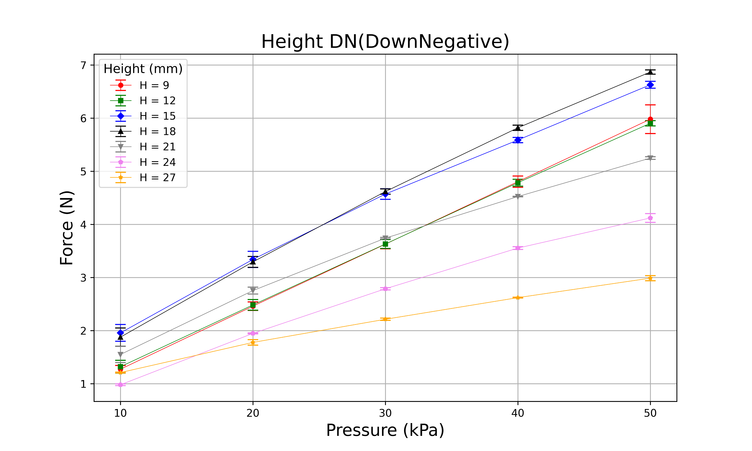
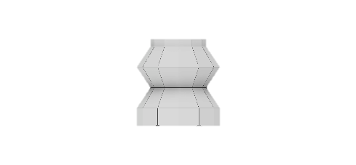
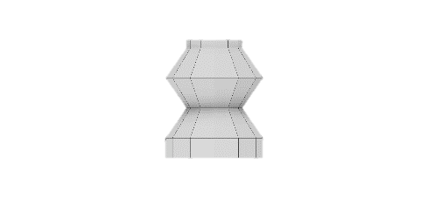
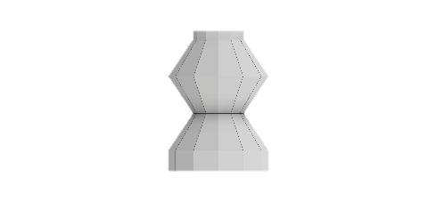
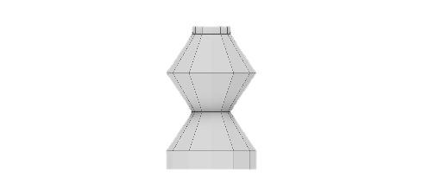
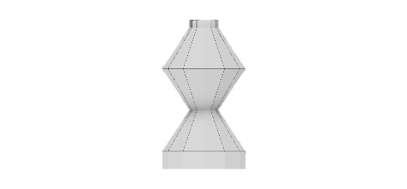
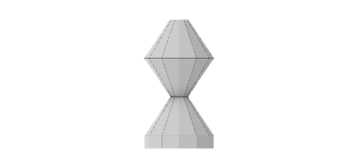
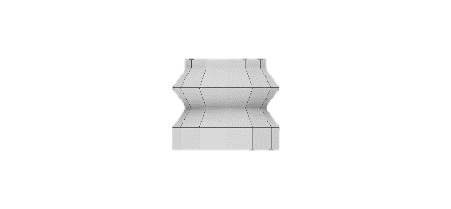
9mm
12mm
15mm
18mm
21mm
24mm
27mm

Slide 3
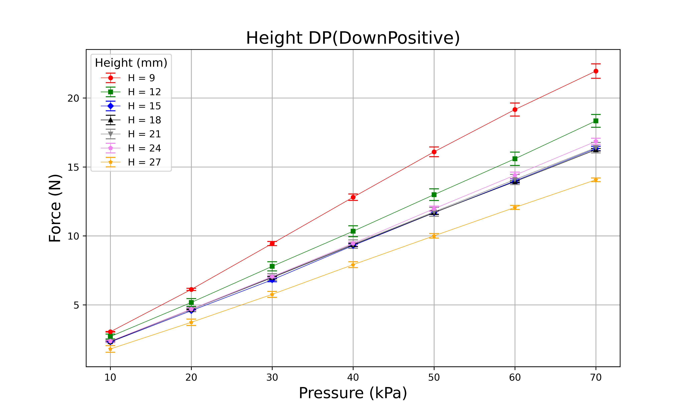
9mm
12mm
15mm
18mm
21mm
24mm
27mm

Slide 4
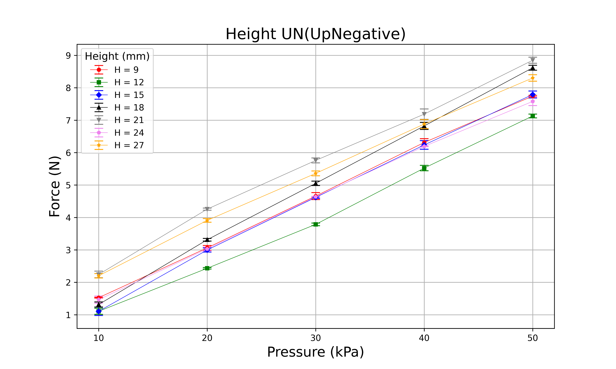
9mm
12mm
15mm
18mm
21mm
24mm
27mm

Slide 5
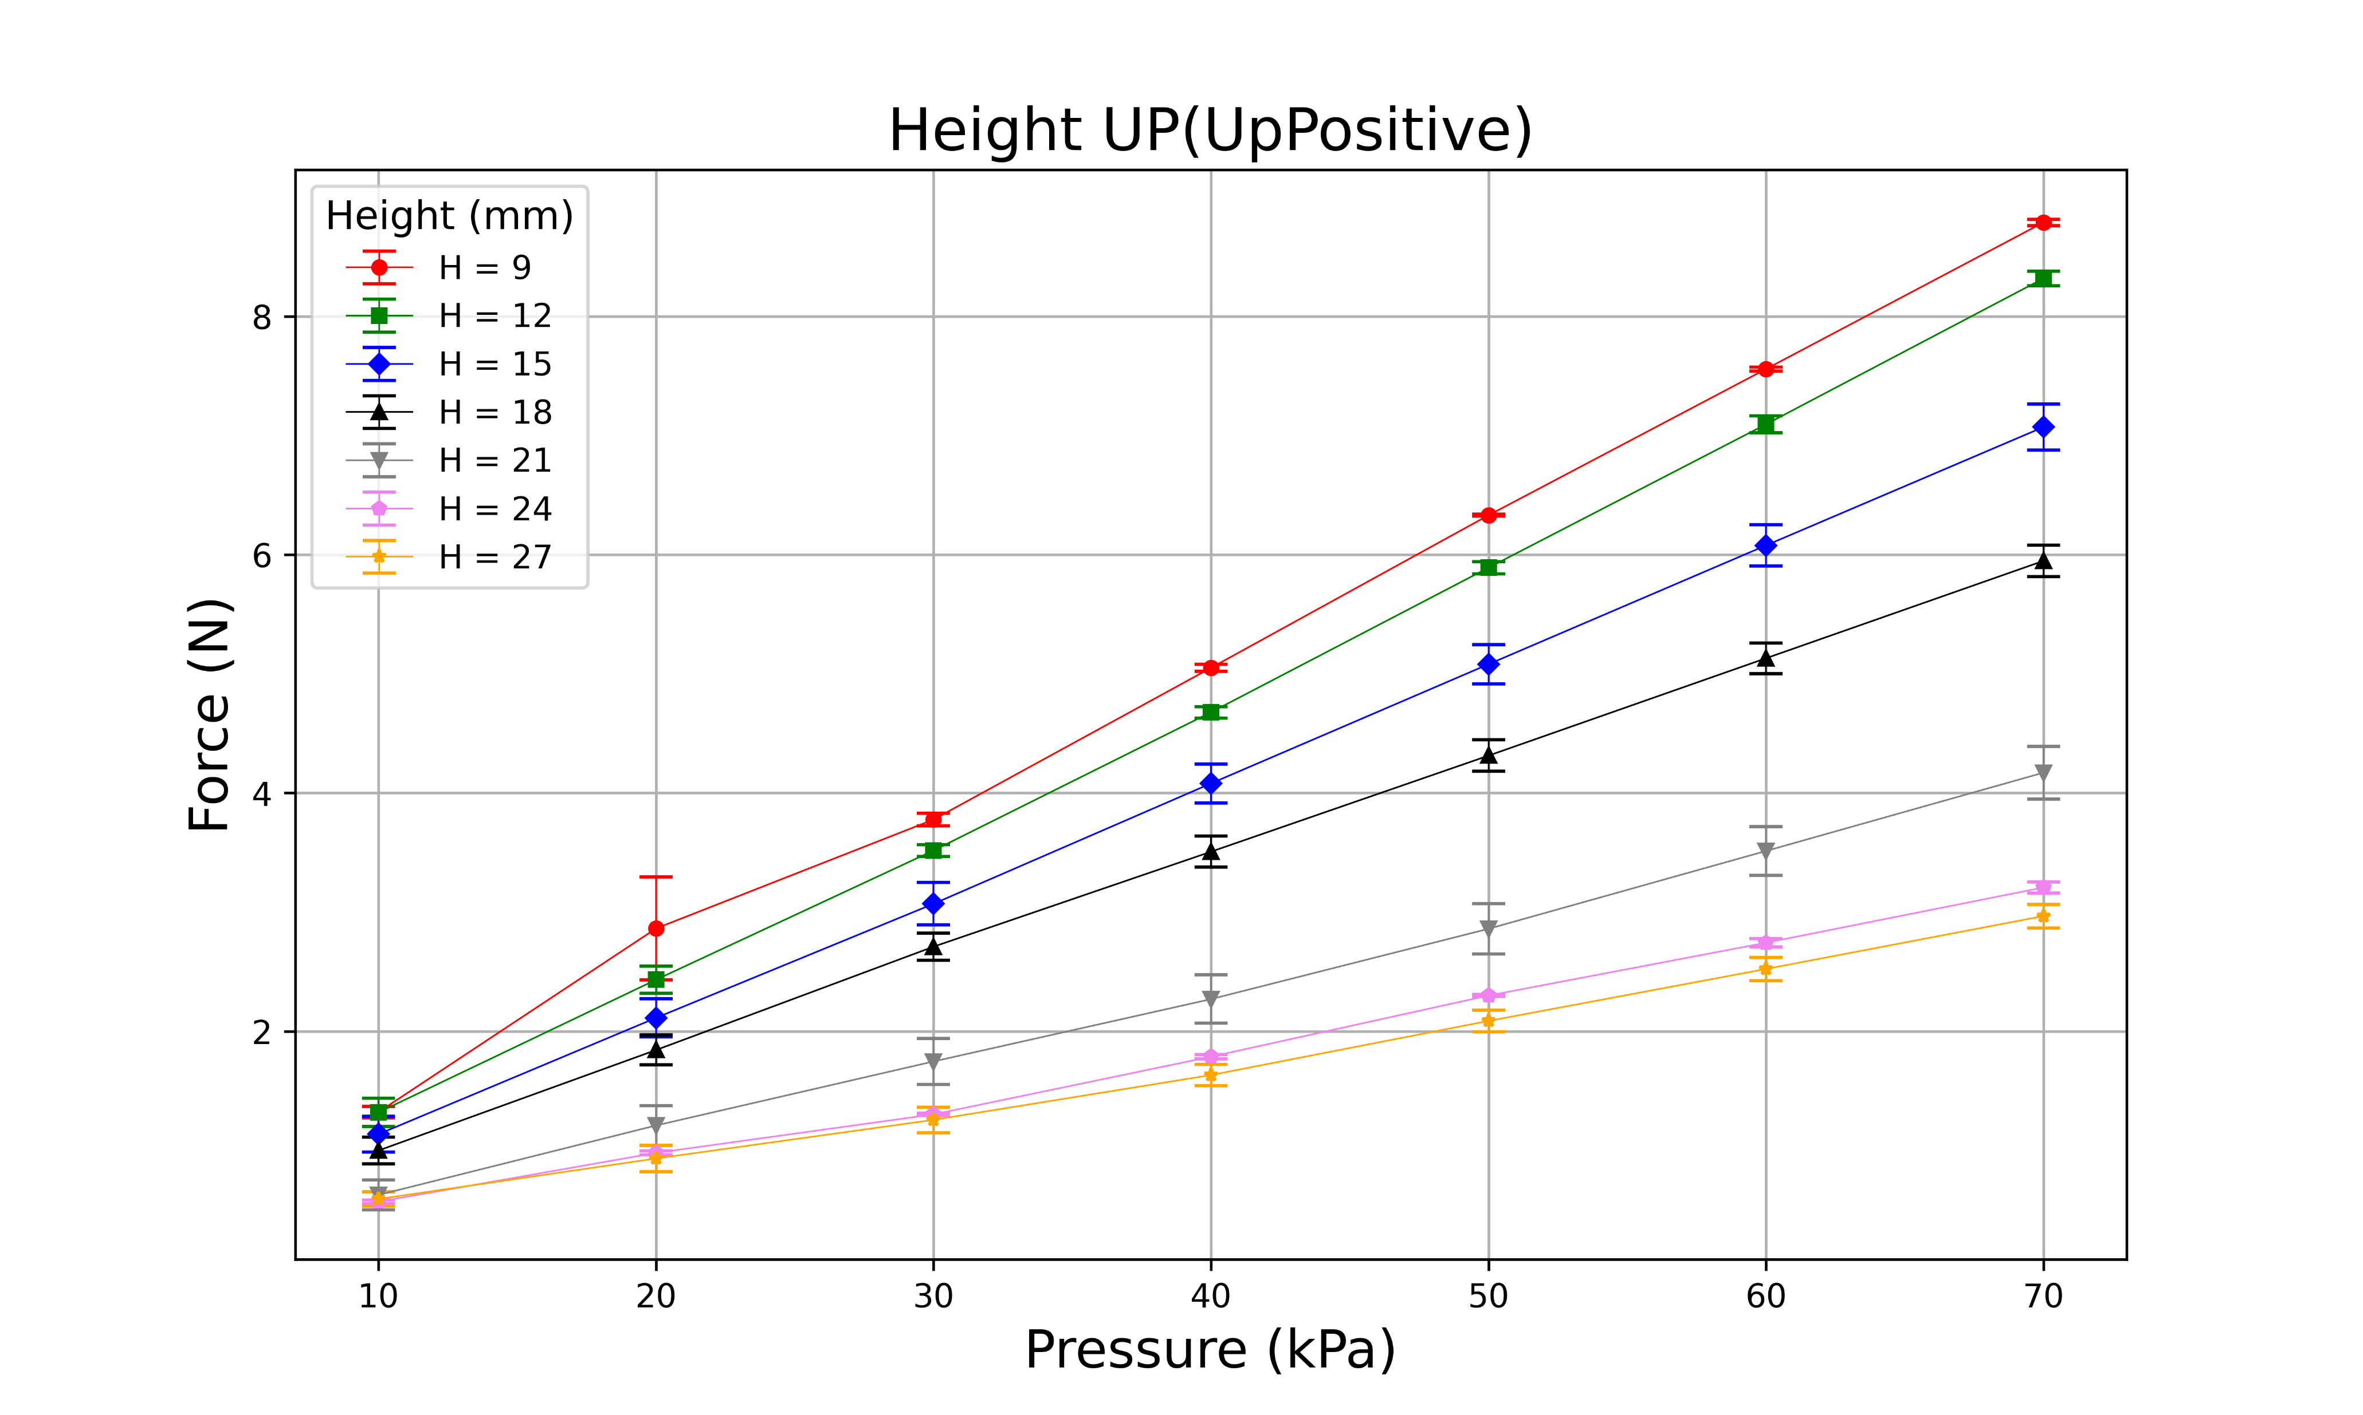
9mm
12mm
15mm
18mm
21mm
24mm
27mm

Slide 6
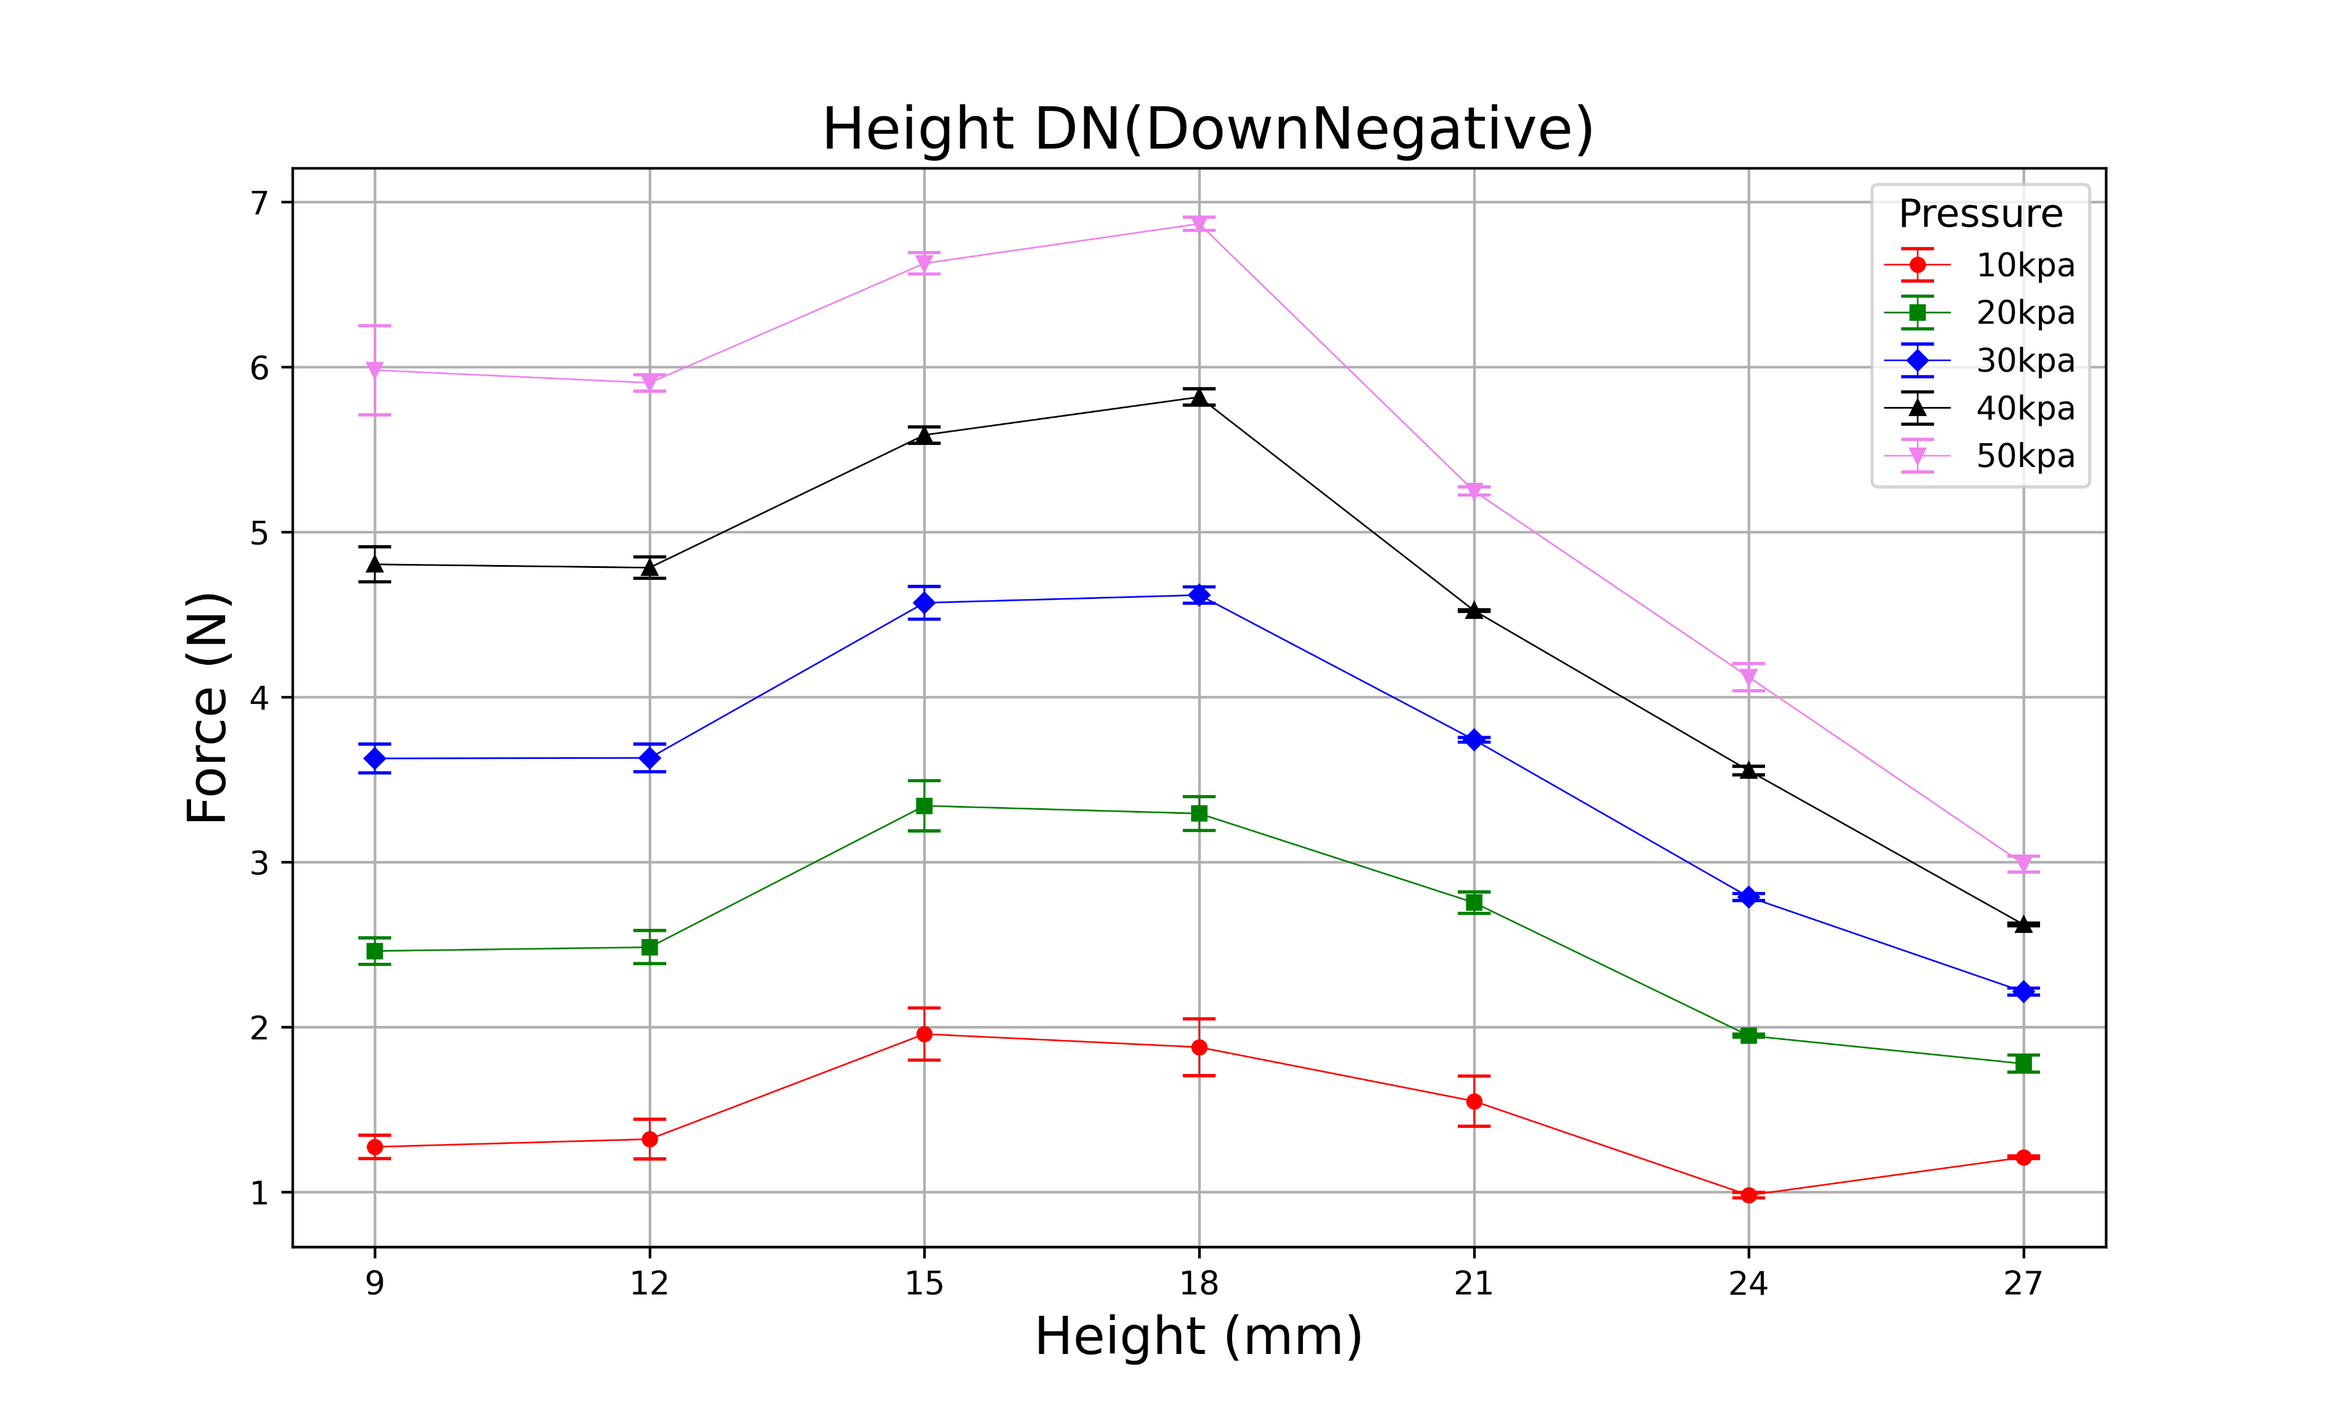
9mm
12mm
15mm
18mm
21mm
24mm
27mm

Slide 7
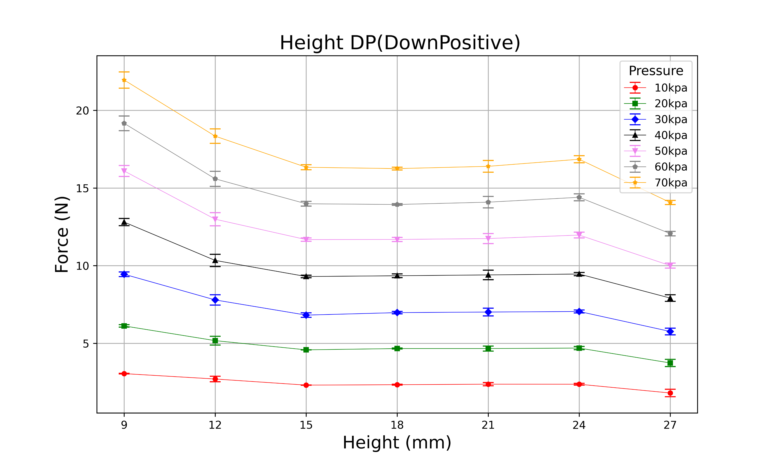
9mm
12mm
15mm
18mm
21mm
24mm
27mm

Slide 8
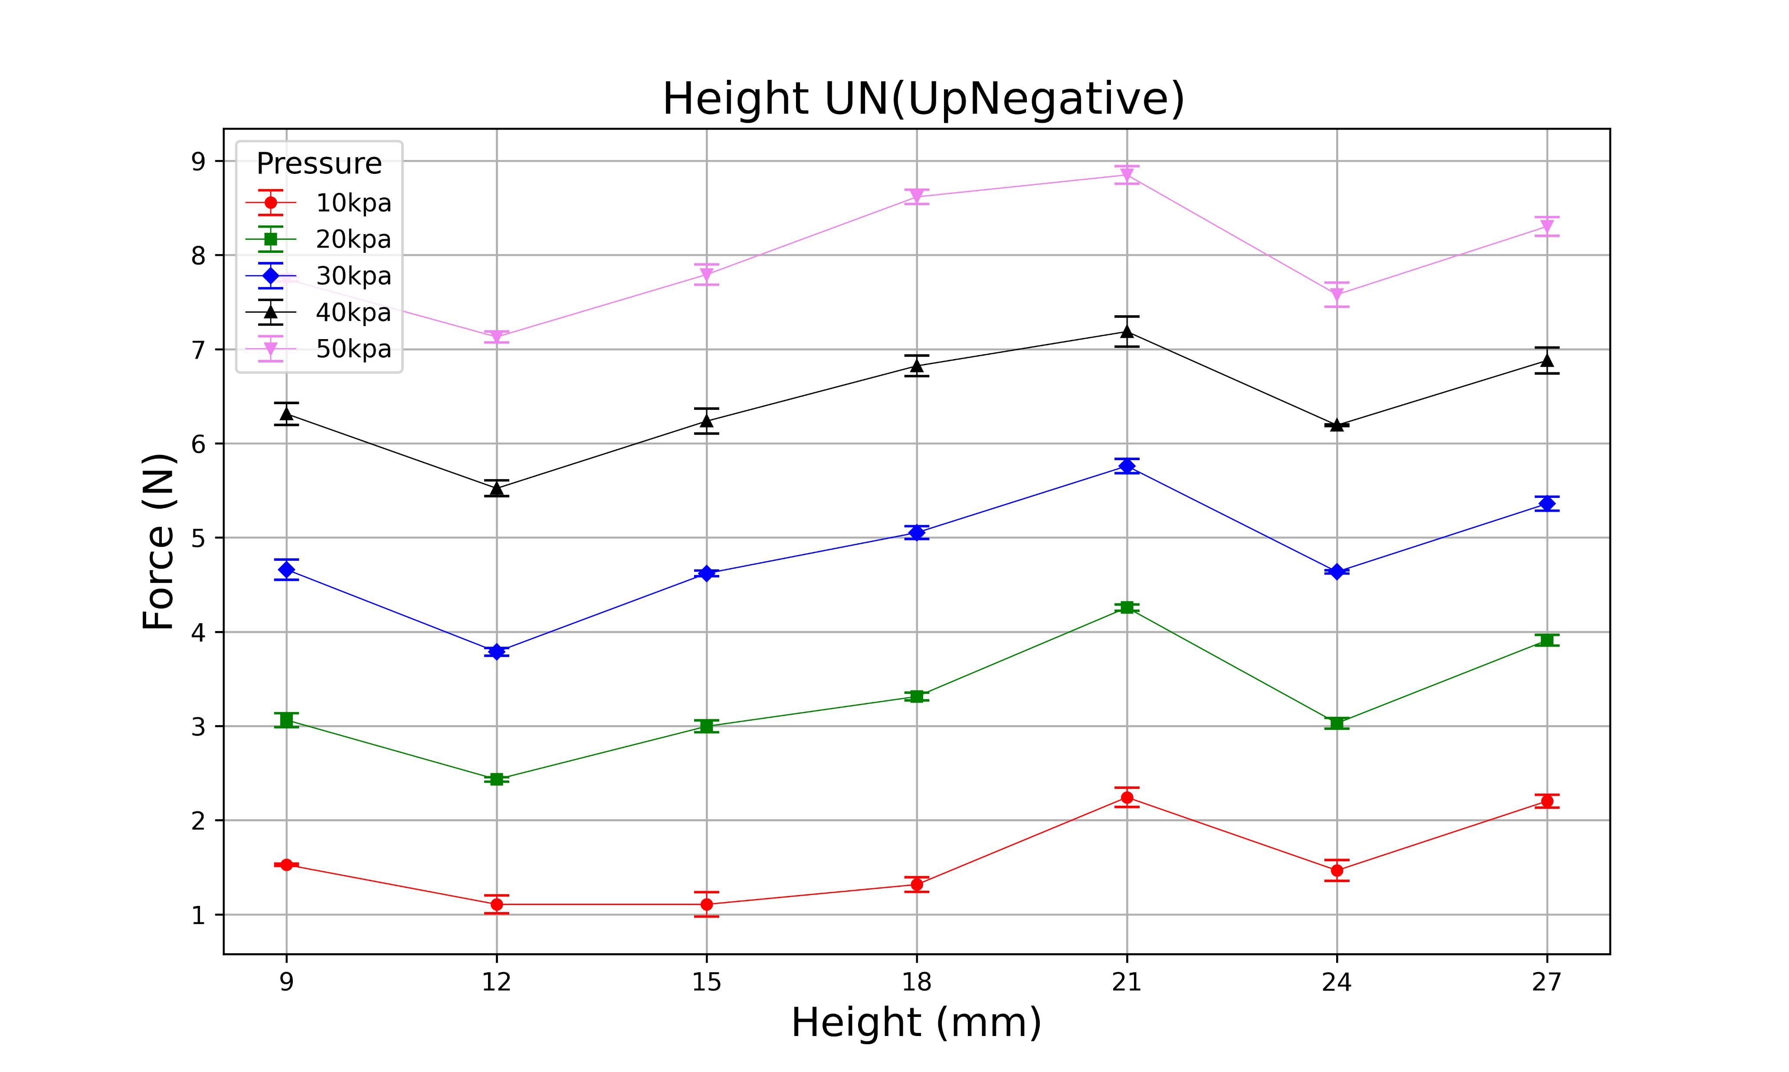
9mm
12mm
15mm
18mm
21mm
24mm
27mm

Slide 9
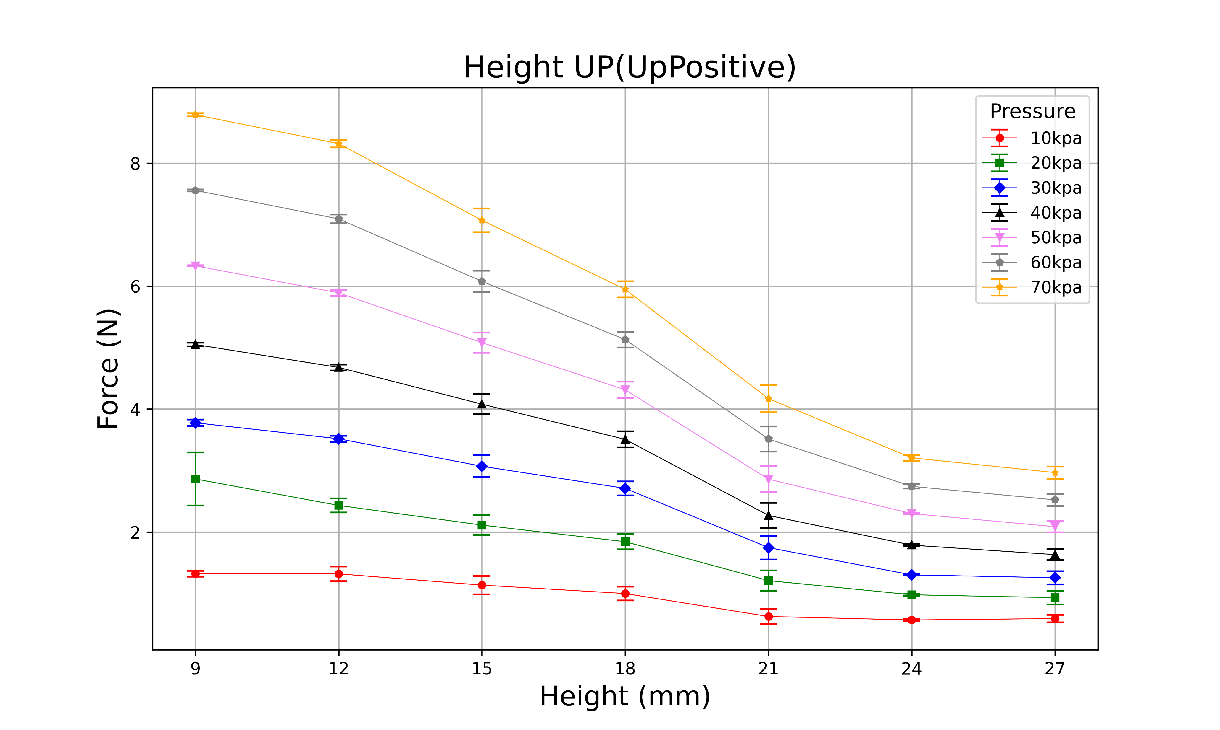
9mm
12mm
15mm
18mm
21mm
24mm
27mm

Slide 10
(H, D, T, N) = (18, 18~33, 0.5, 12)

Slide 11

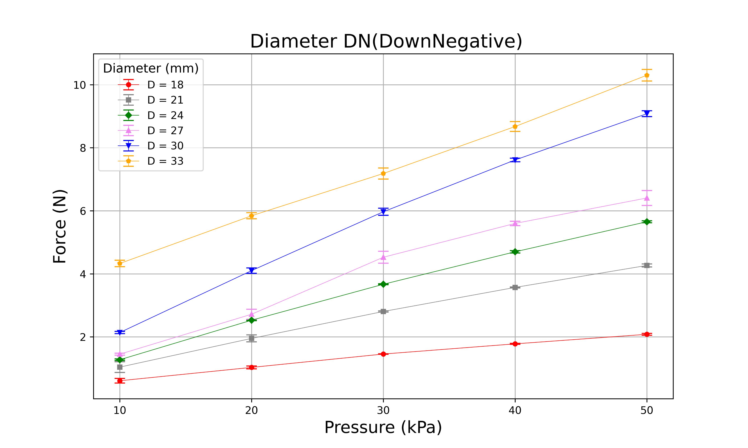
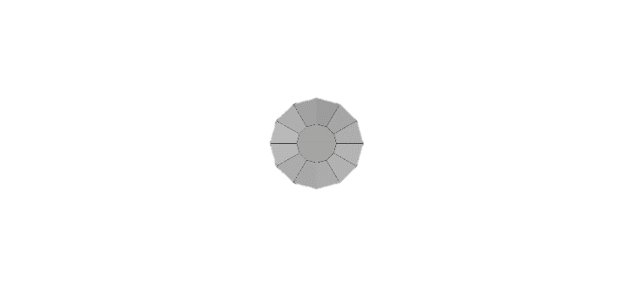
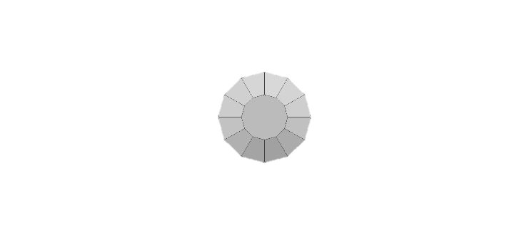
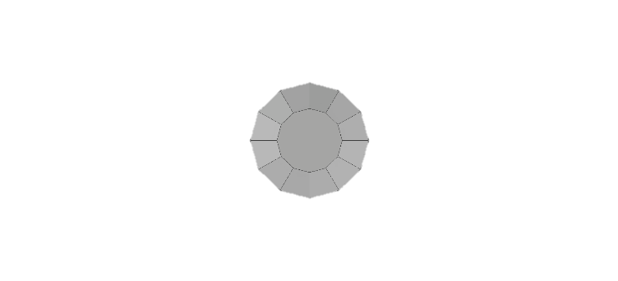
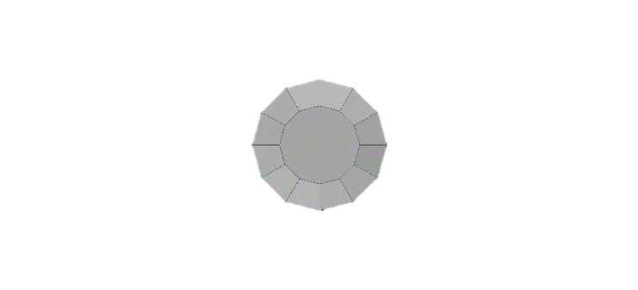
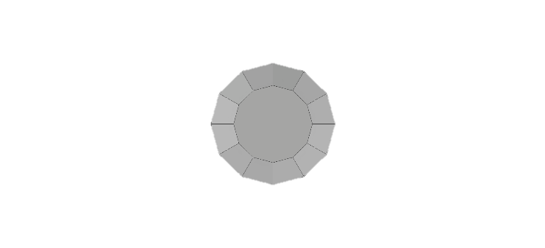
18mm
21mm
24mm
27mm
30mm
33mm

Slide 12
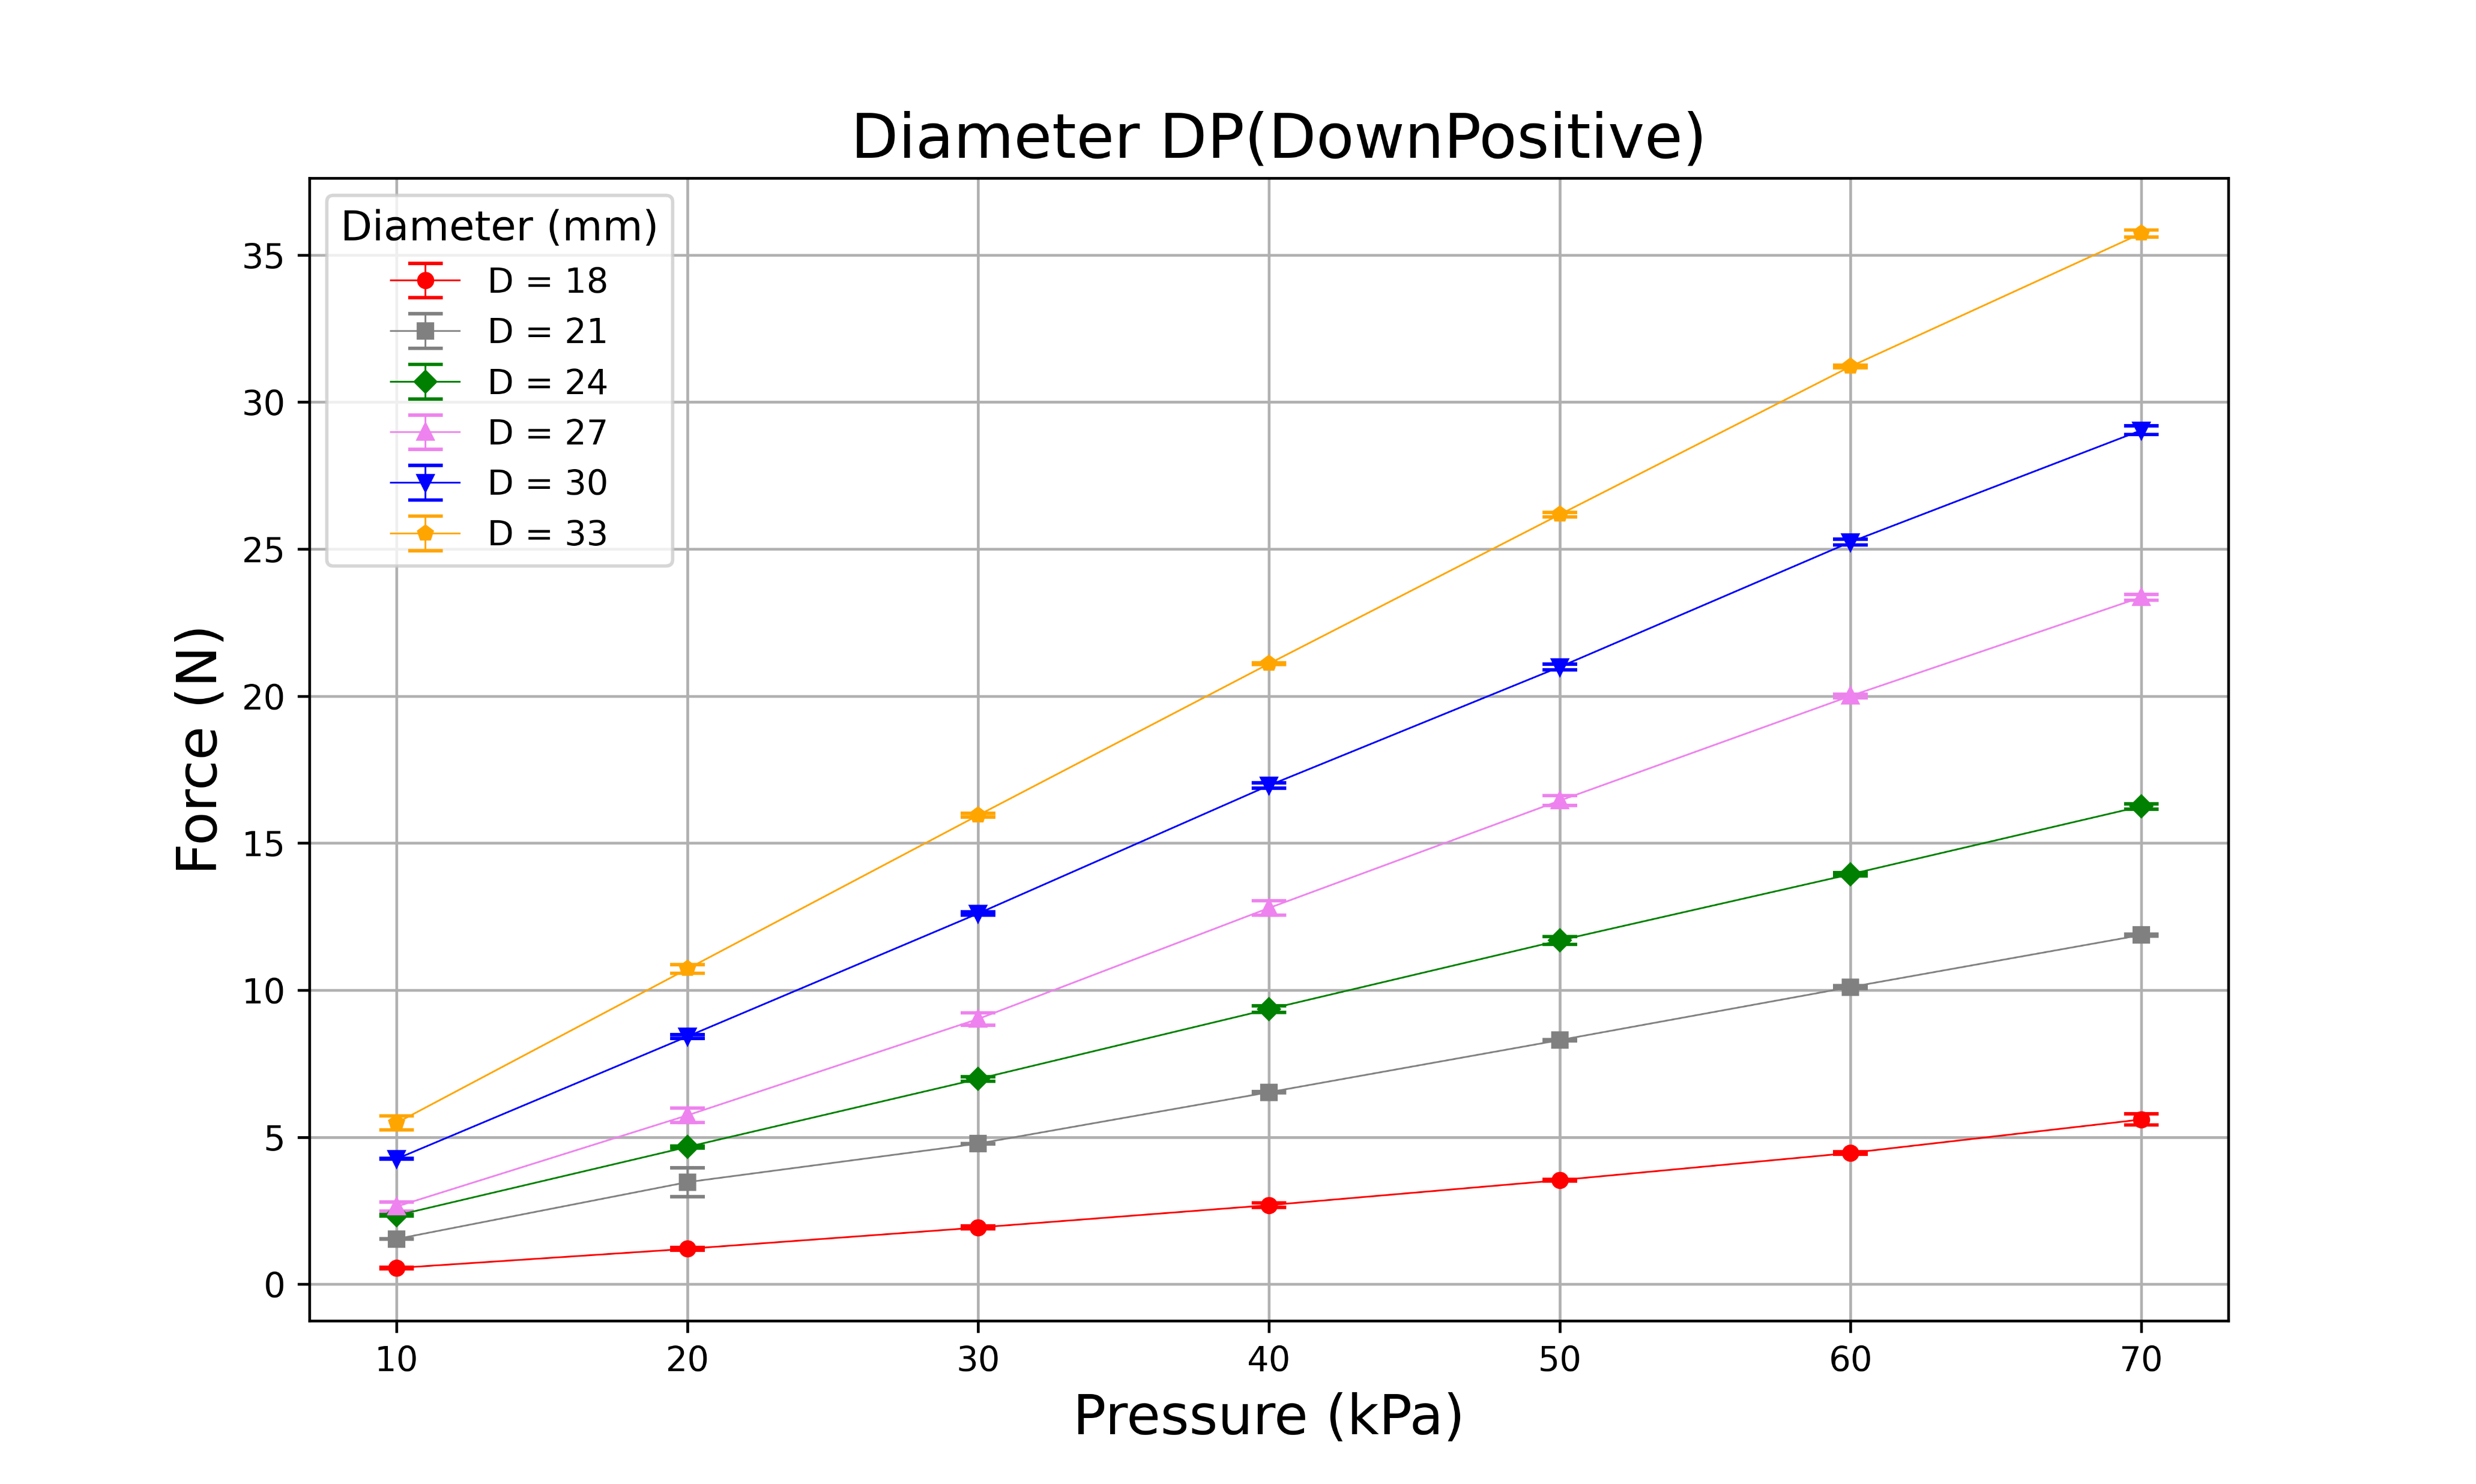
18mm
21mm
24mm
27mm
30mm
33mm

Slide 13
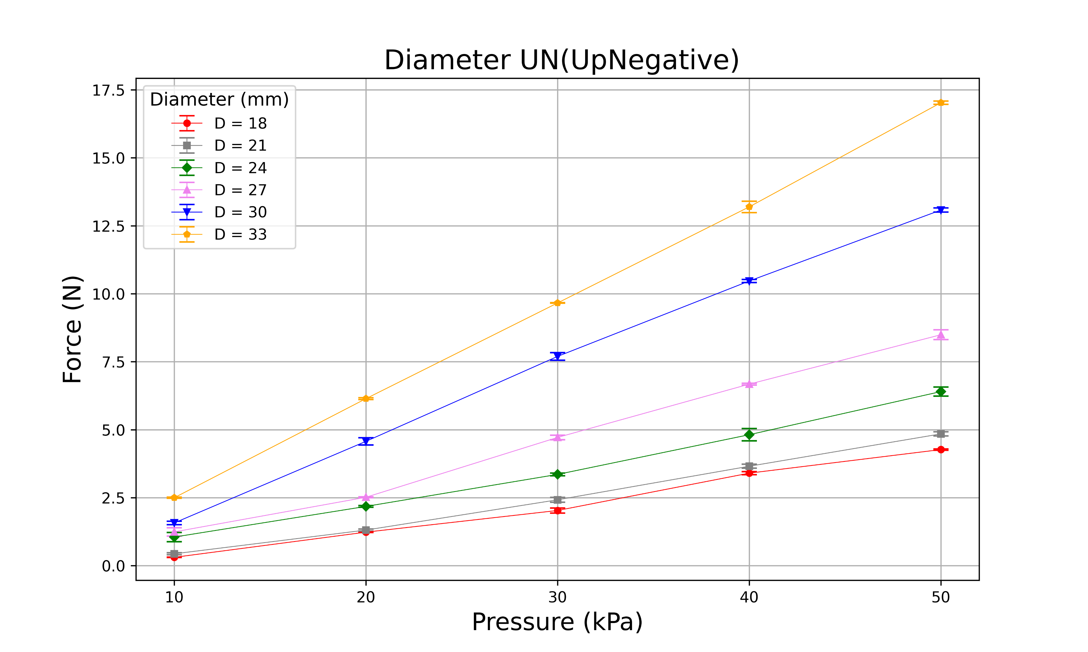
18mm
21mm
24mm
27mm
30mm
33mm

Slide 14
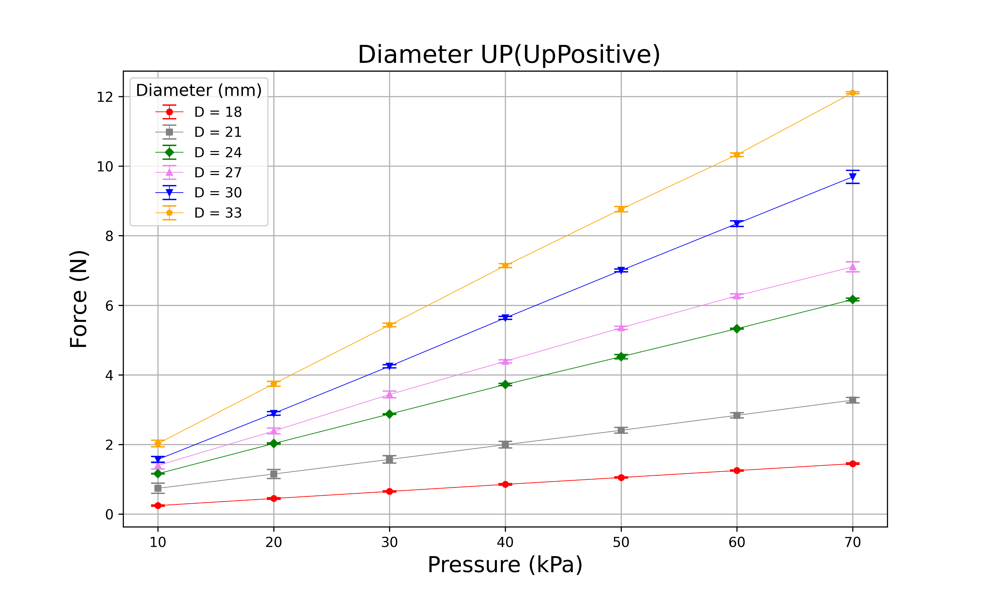
18mm
21mm
24mm
27mm
30mm
33mm

Slide 15
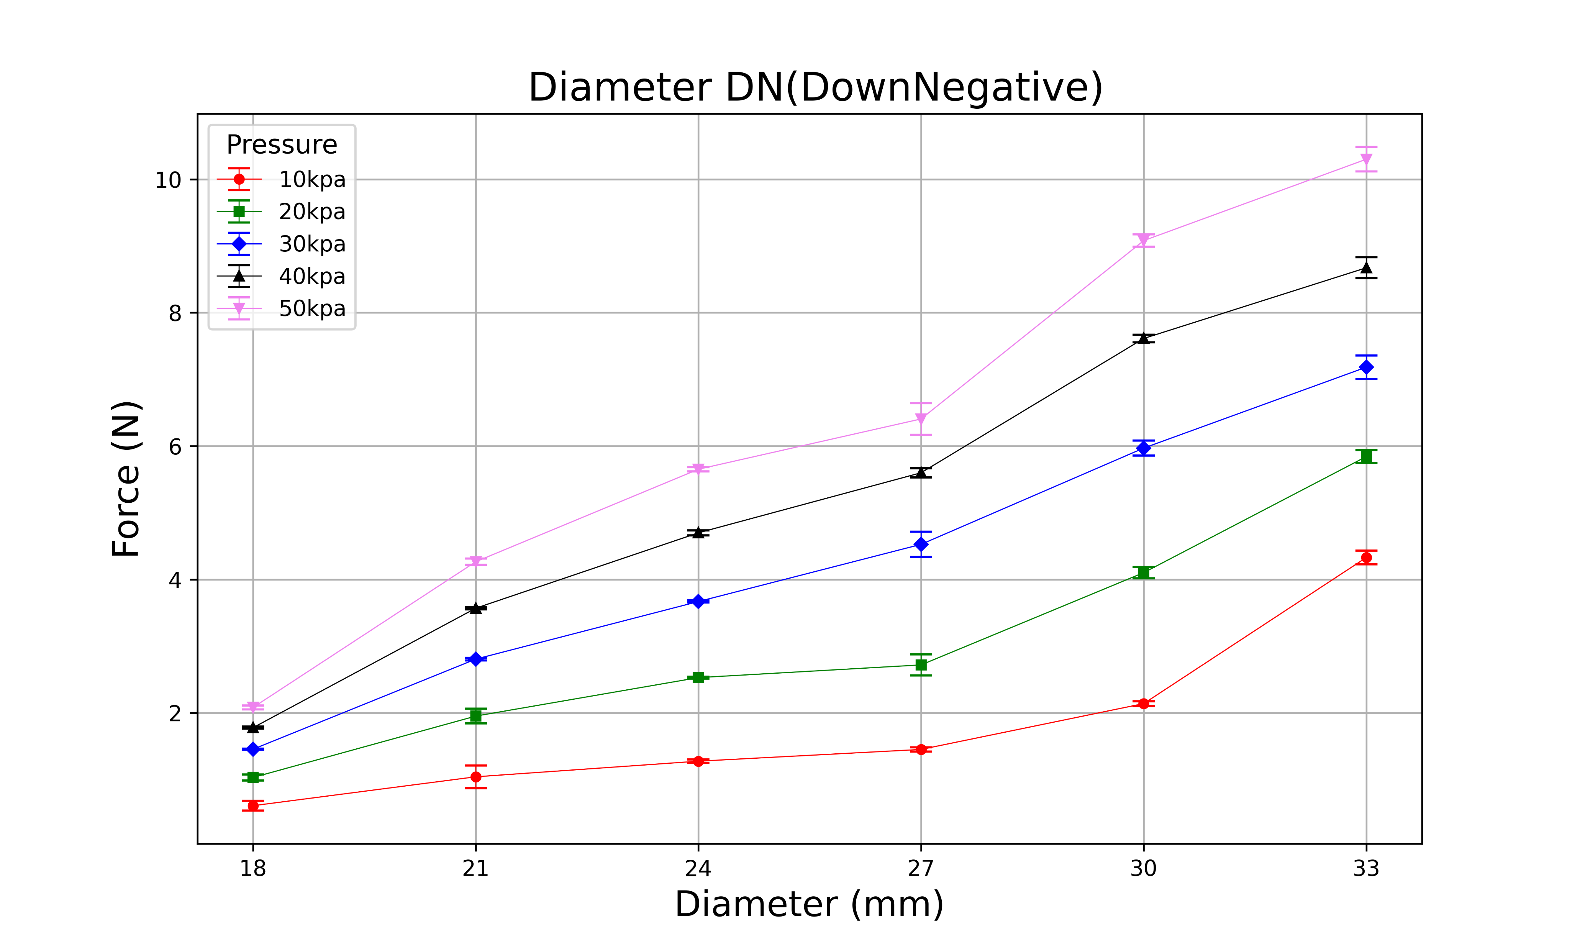
18mm
21mm
24mm
27mm
30mm
33mm

Slide 16
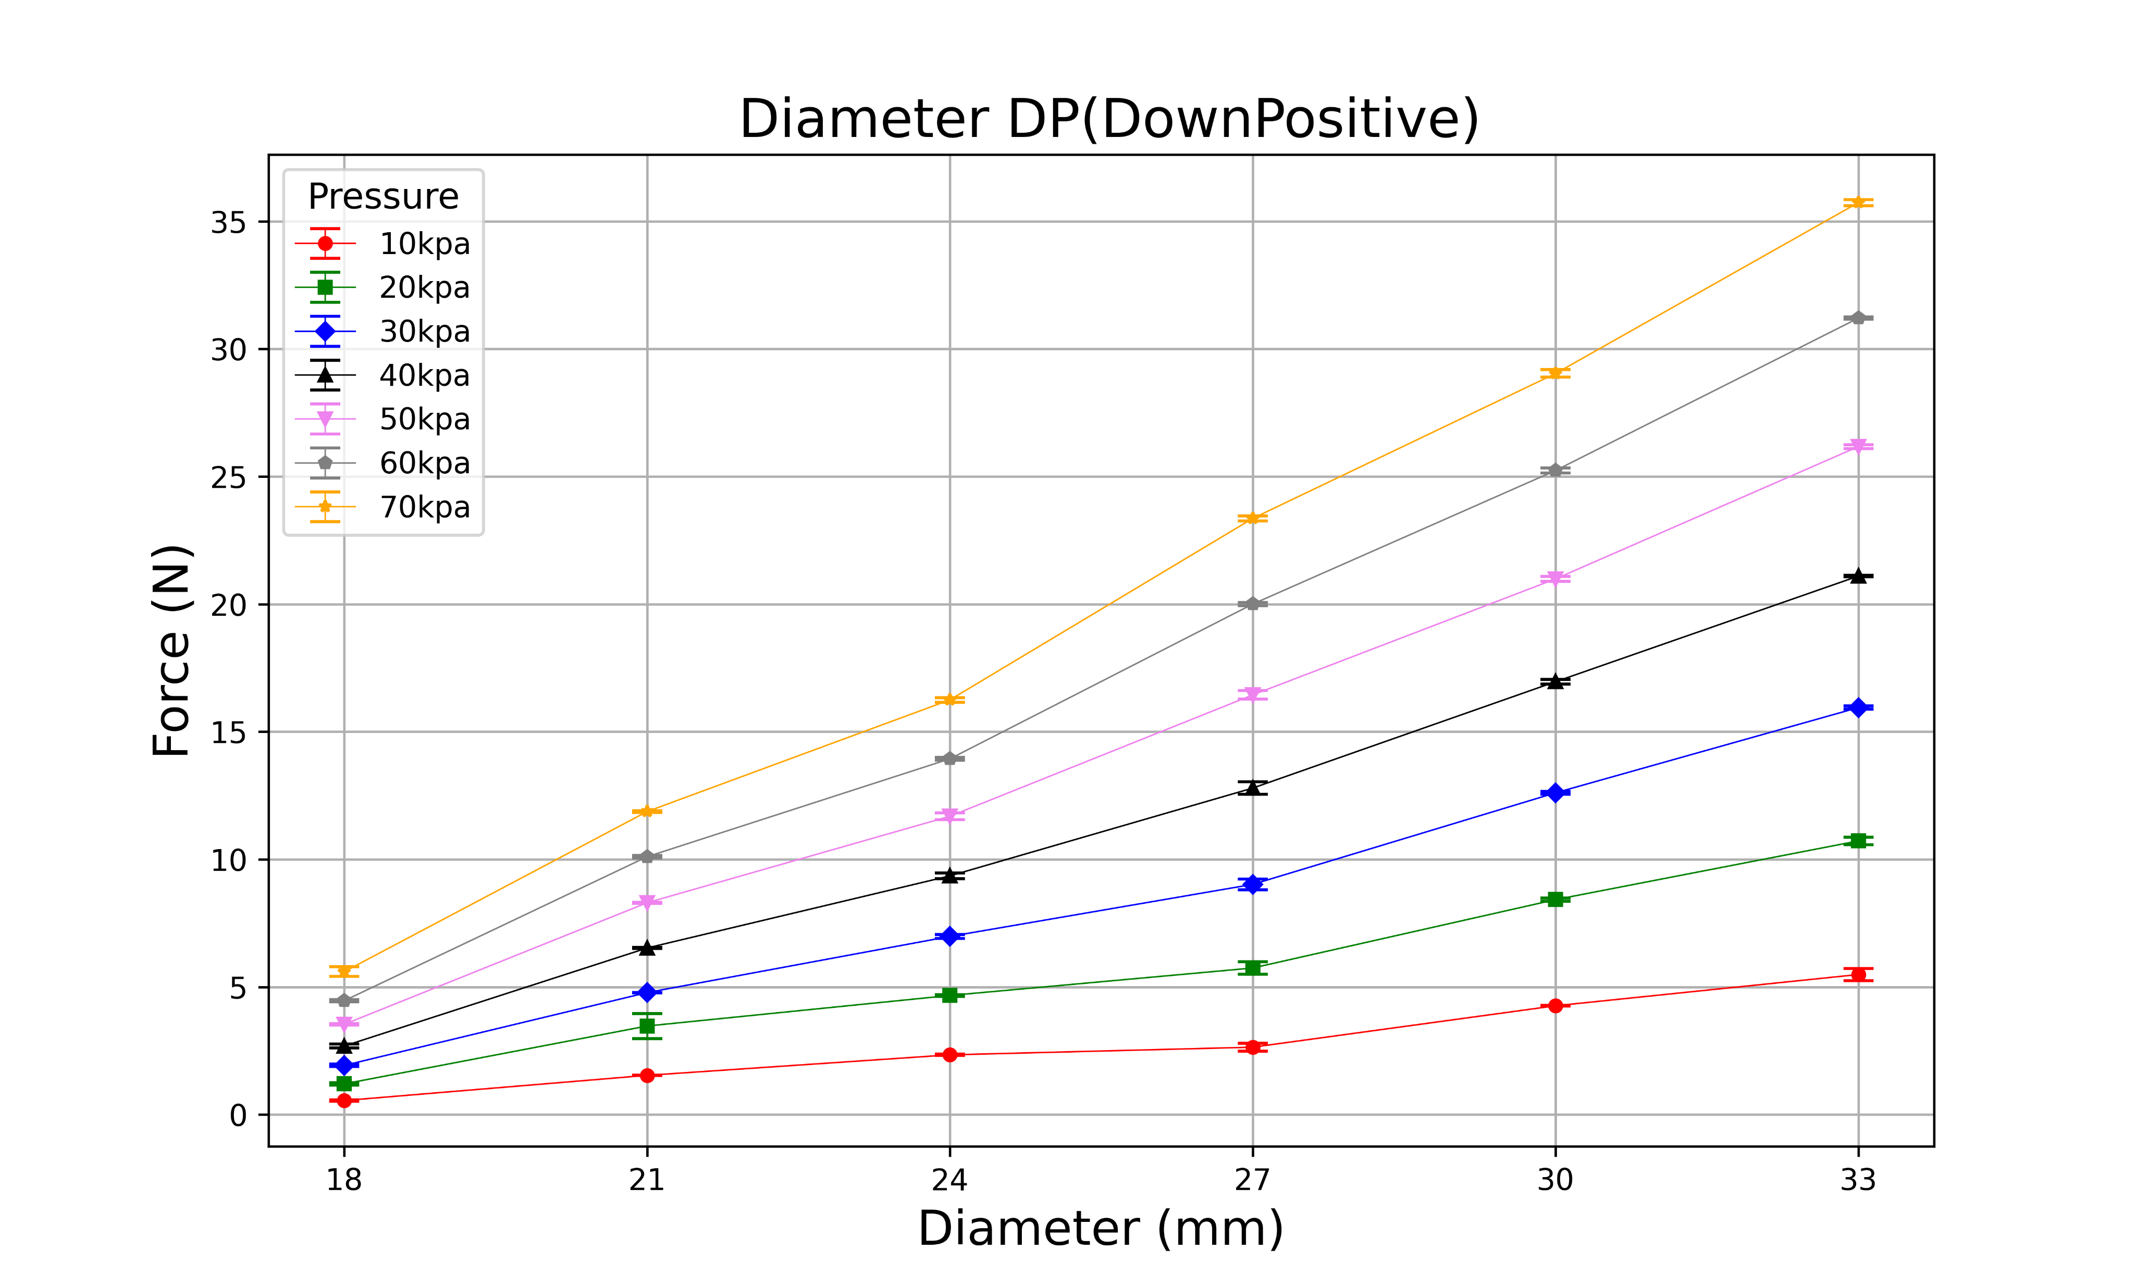
18mm
21mm
24mm
27mm
30mm
33mm

Slide 17
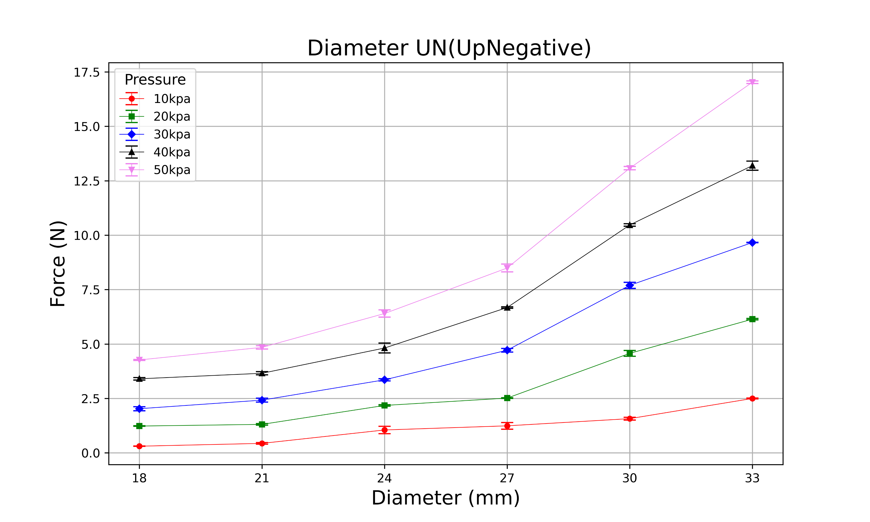
18mm
21mm
24mm
27mm
30mm
33mm

Slide 18
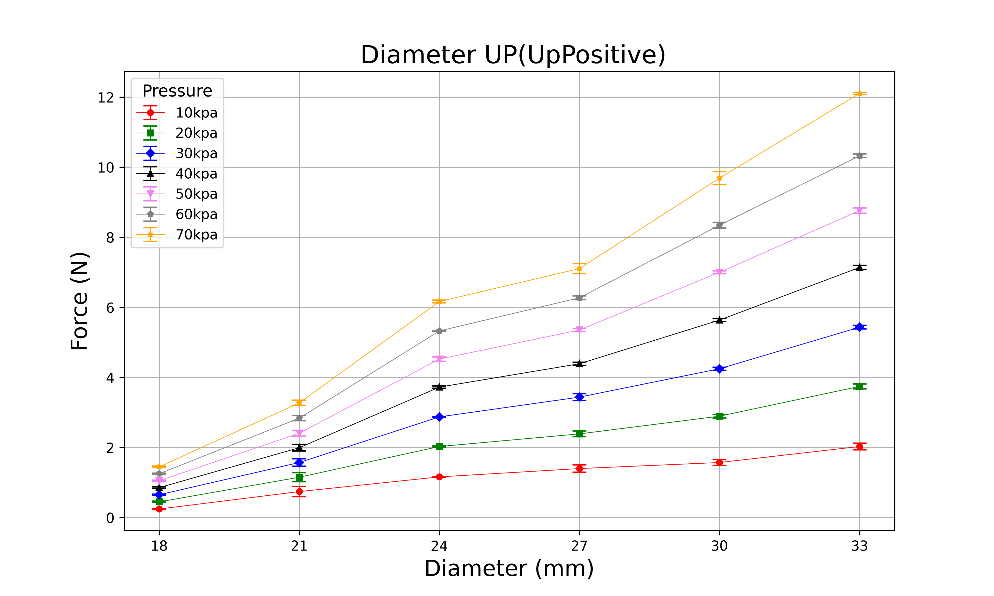
18mm
21mm
24mm
27mm
30mm
33mm

Slide 19
(H, D, T, N) = (18, 24, 0.5~0.9, 12)

Slide 20
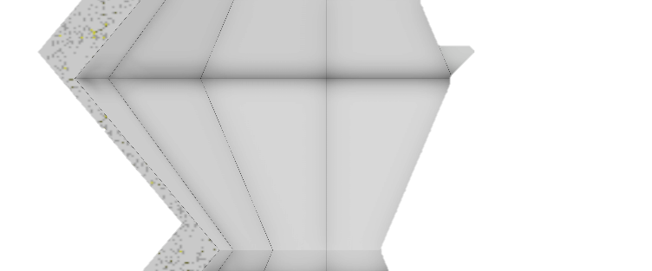
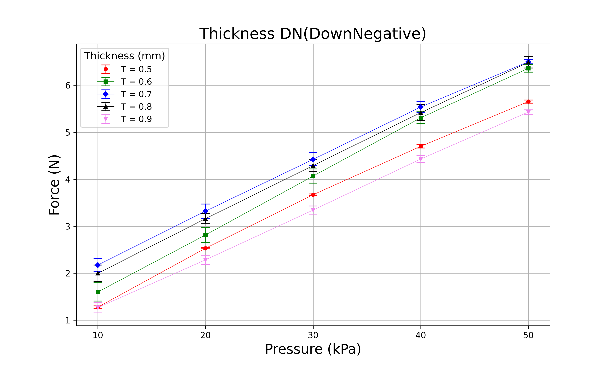
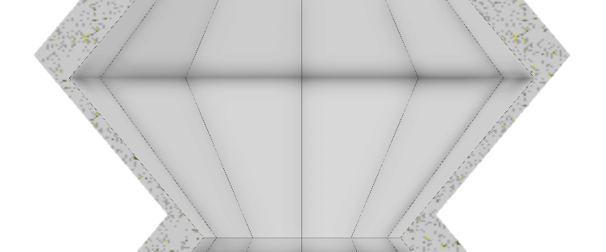
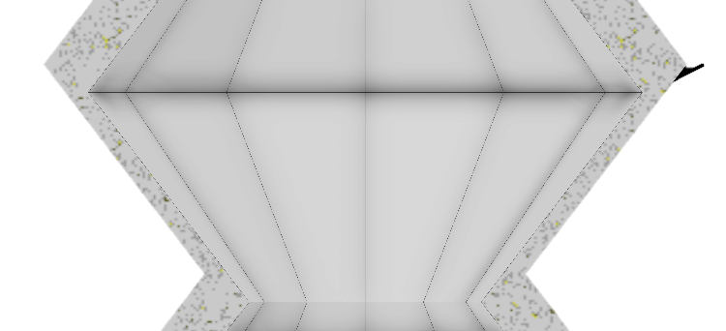
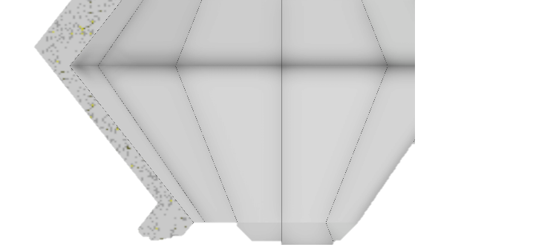
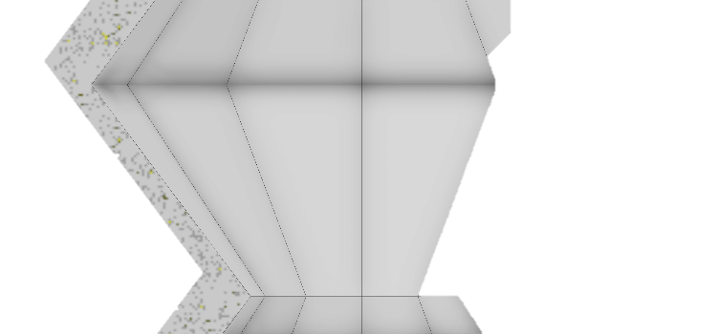
T
0.5mm
0.6mm
0.7mm
0.8mm
0.9mm

Slide 21
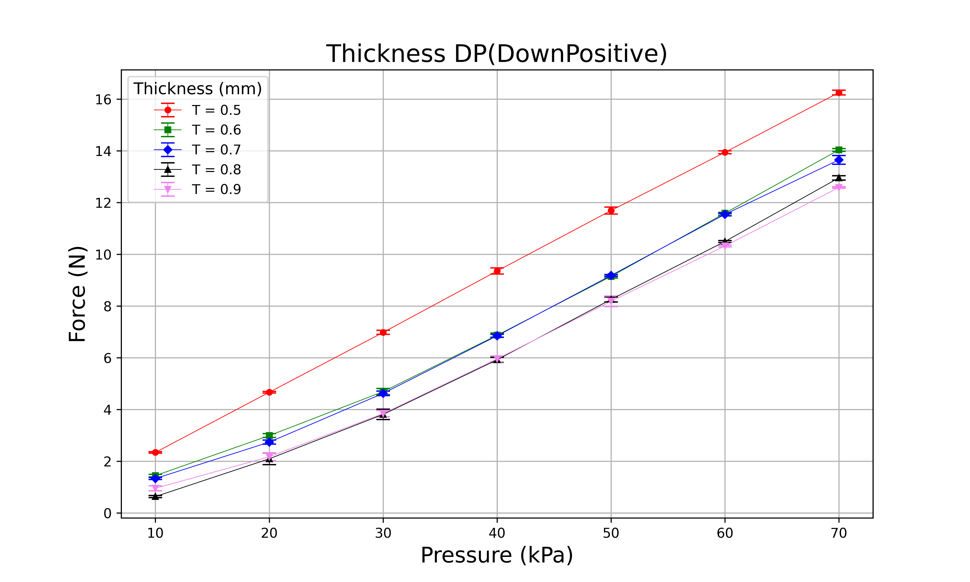
T
0.5mm
0.6mm
0.7mm
0.8mm
0.9mm

Slide 22
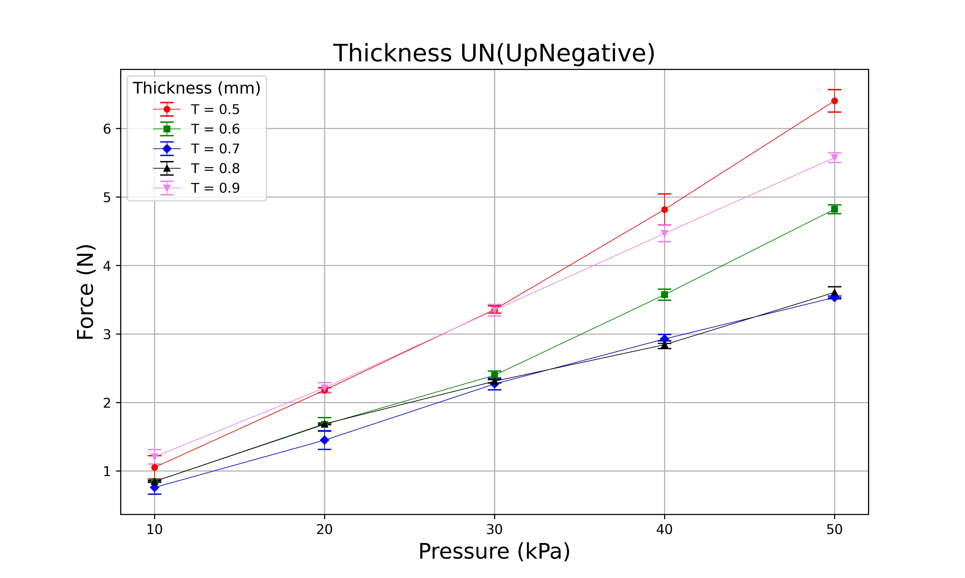
T
0.5mm
0.6mm
0.7mm
0.8mm
0.9mm

Slide 23
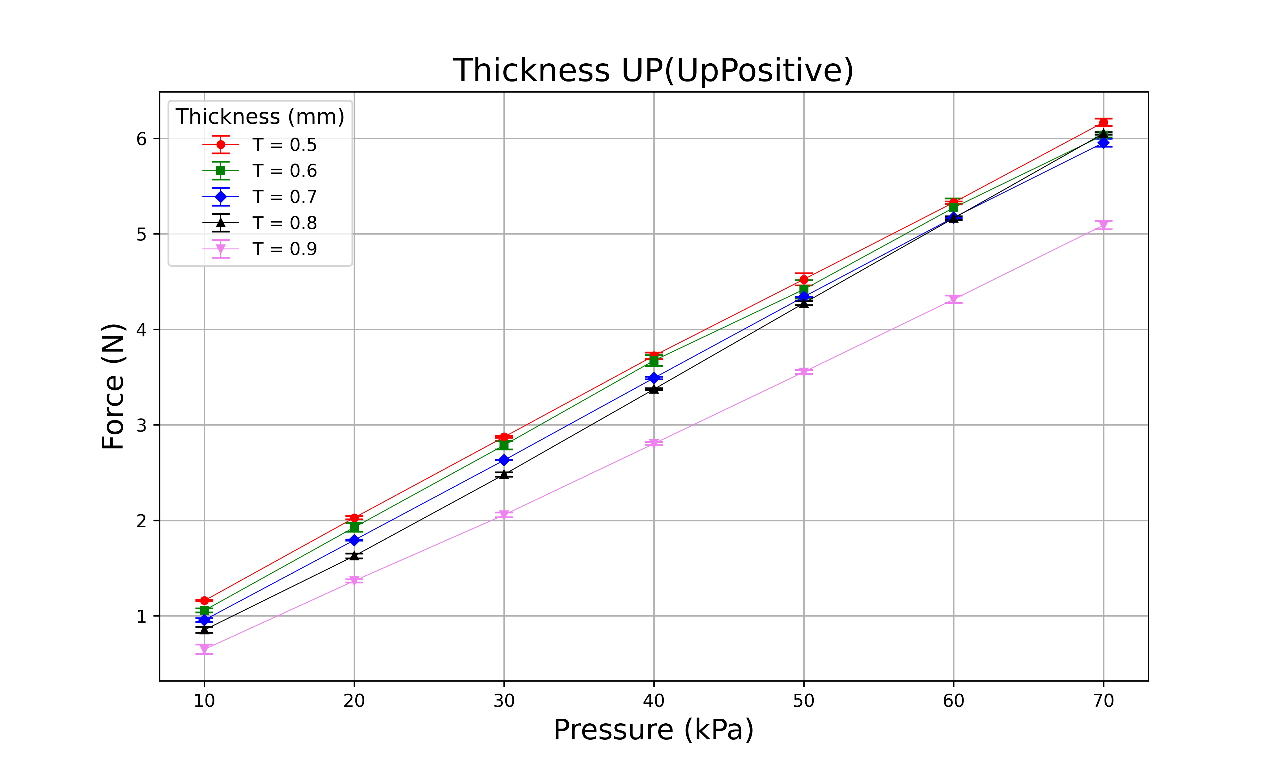
T
0.5mm
0.6mm
0.7mm
0.8mm
0.9mm

Slide 24
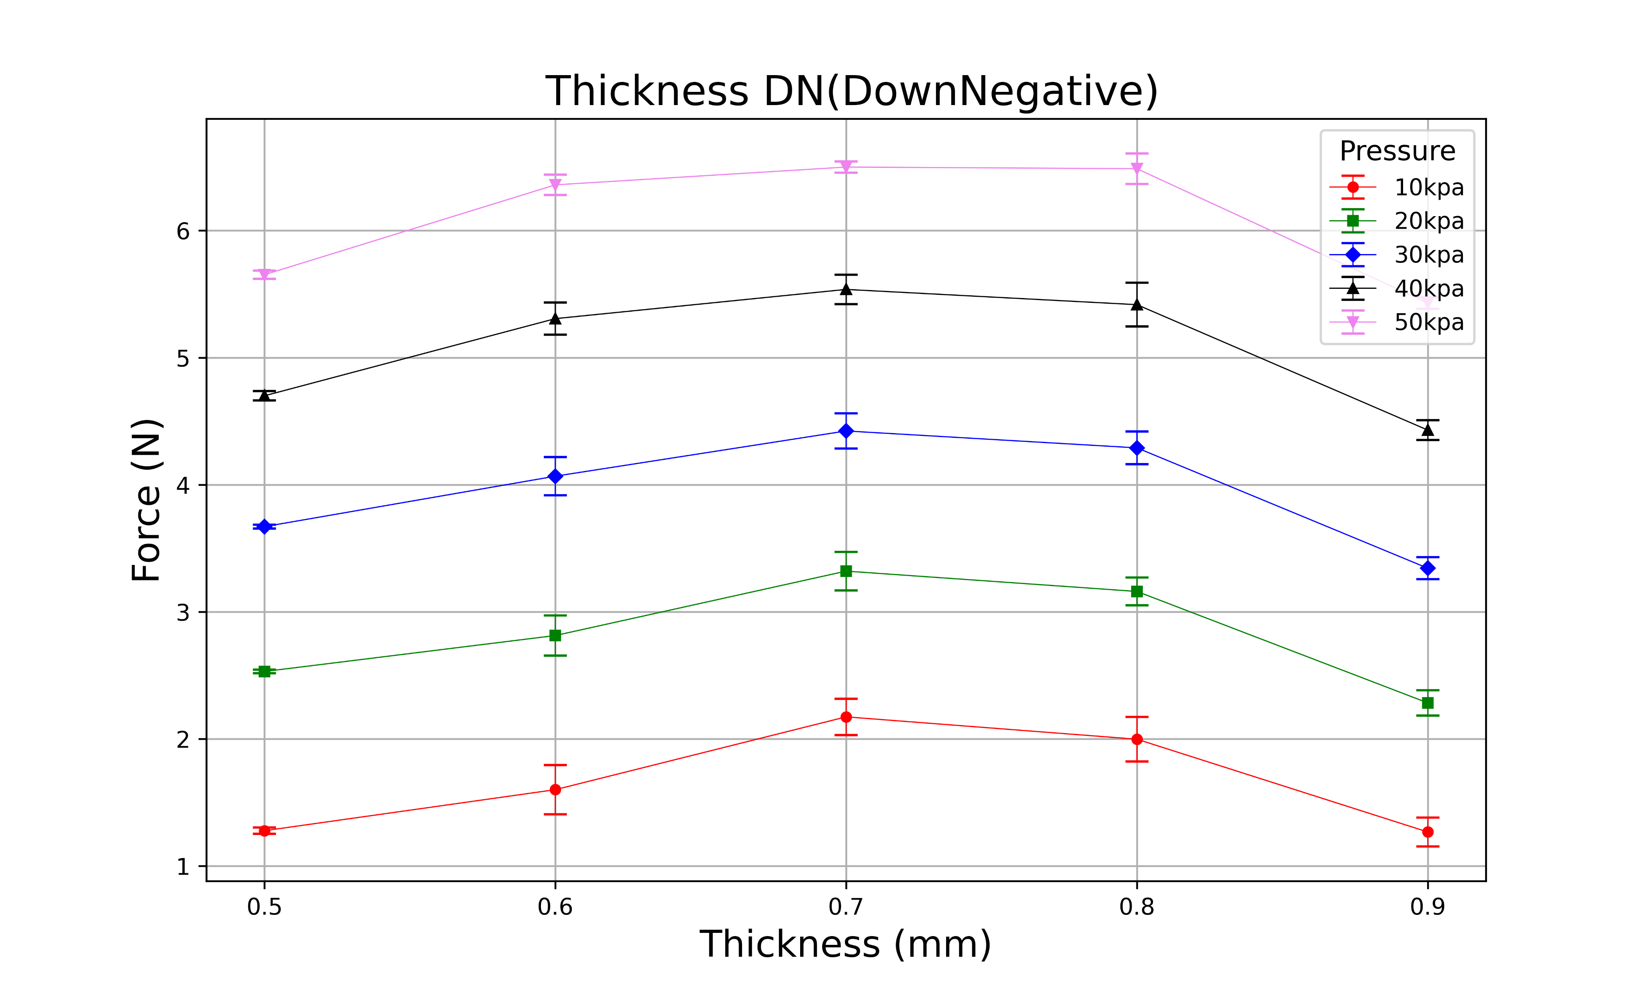
T
0.5mm
0.6mm
0.7mm
0.8mm
0.9mm

Slide 25
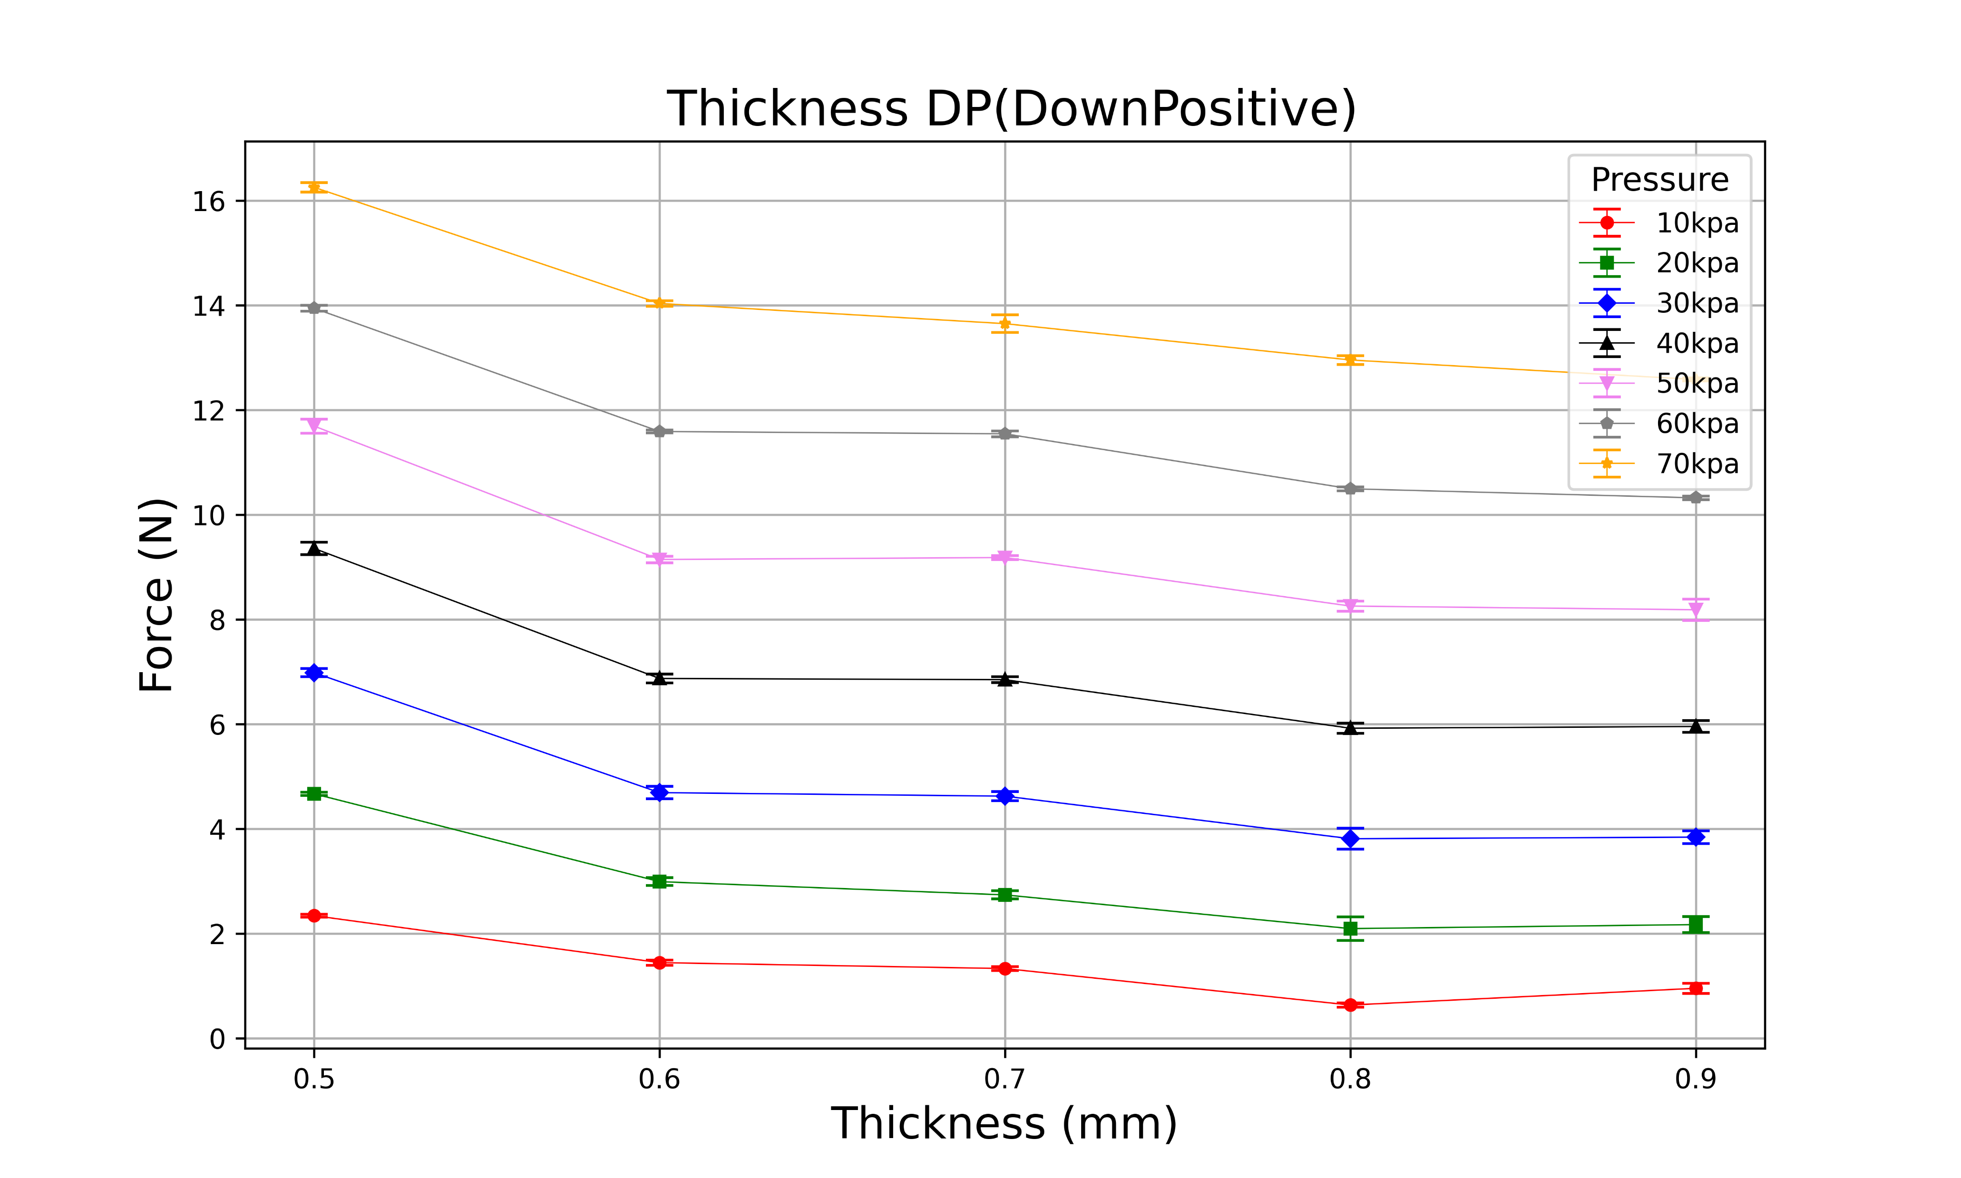
T
0.5mm
0.6mm
0.7mm
0.8mm
0.9mm

Slide 26
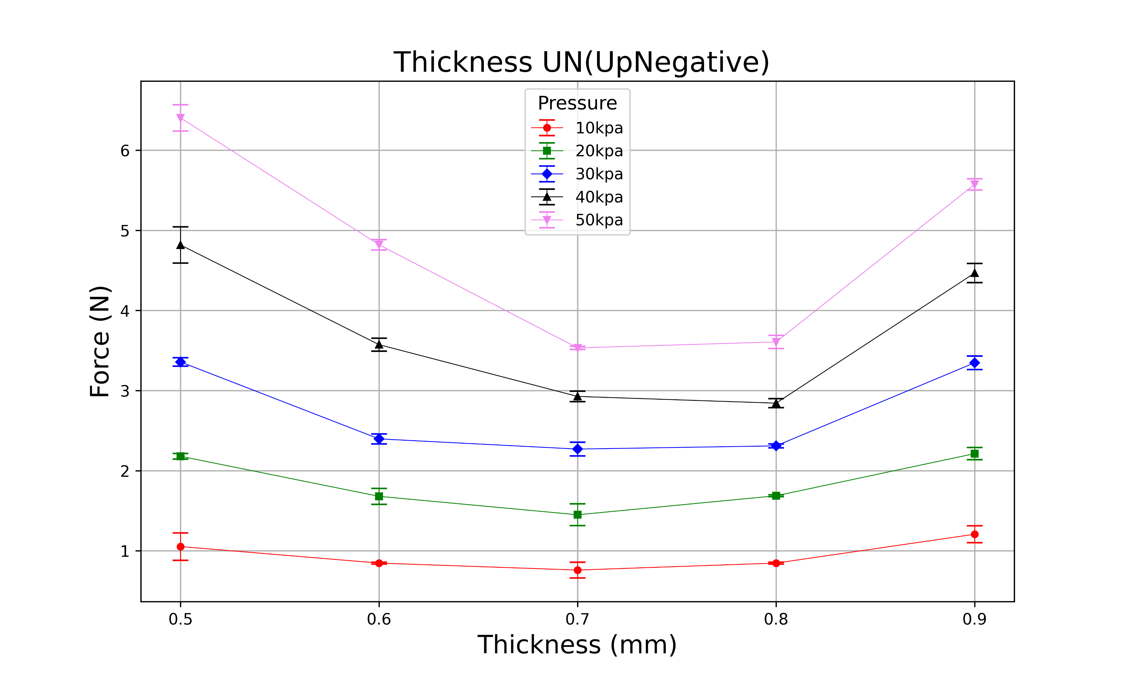
T
0.5mm
0.6mm
0.7mm
0.8mm
0.9mm

Slide 27
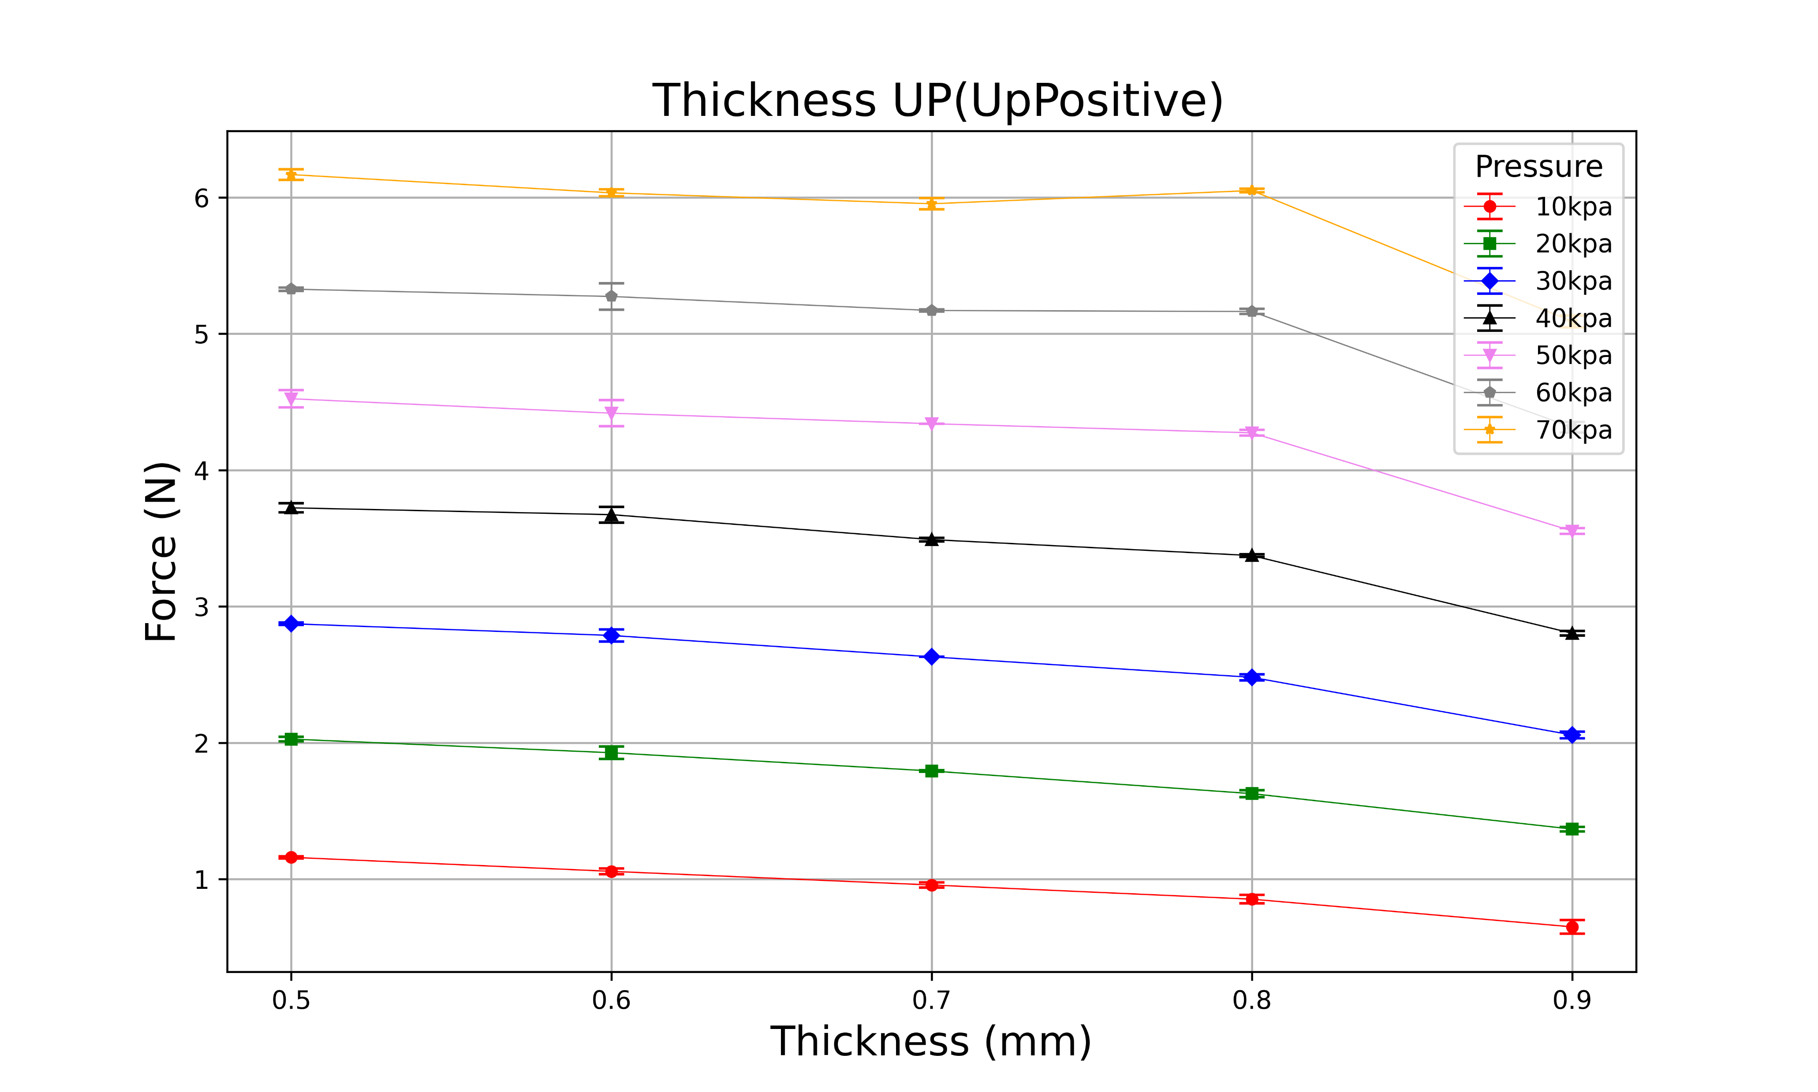
T
0.5mm
0.6mm
0.7mm
0.8mm
0.9mm

Slide 28
(H, D, T, N) = (18, 24, 0.5, 4~12)

Slide 29
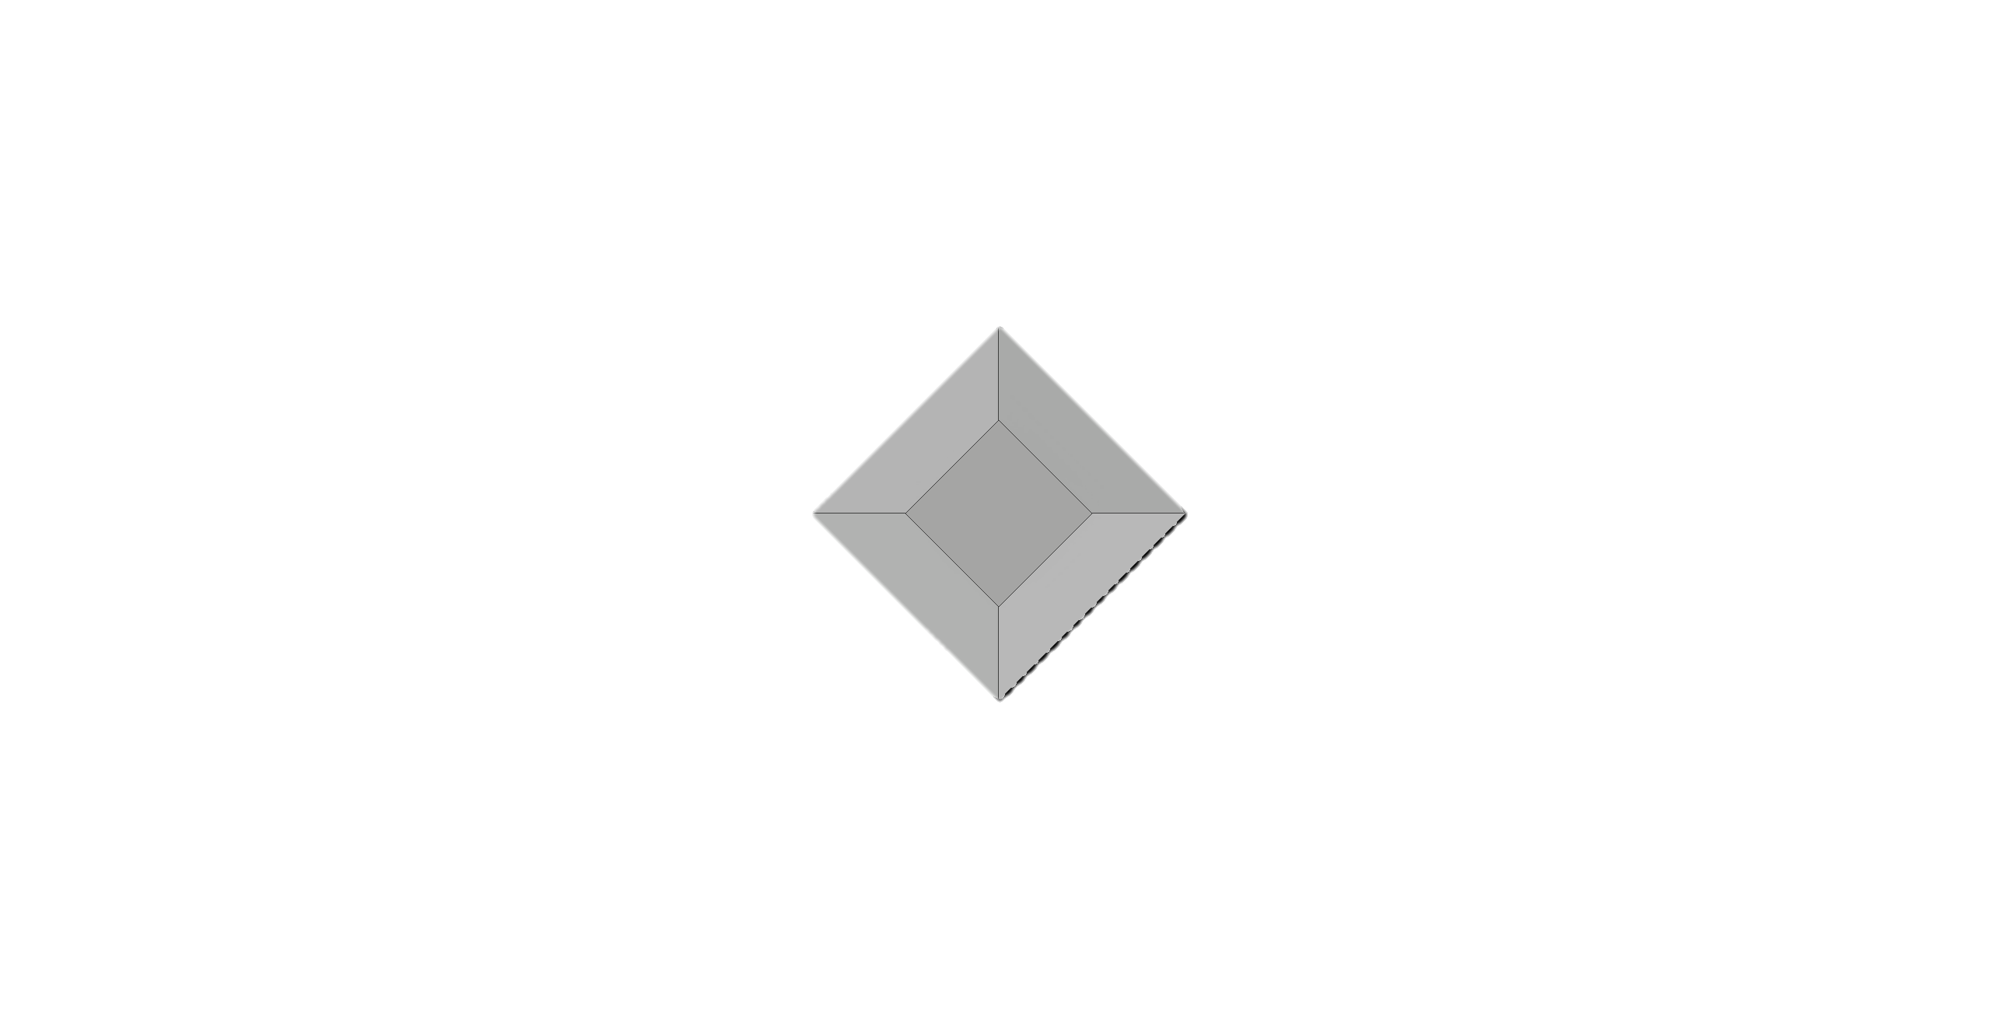
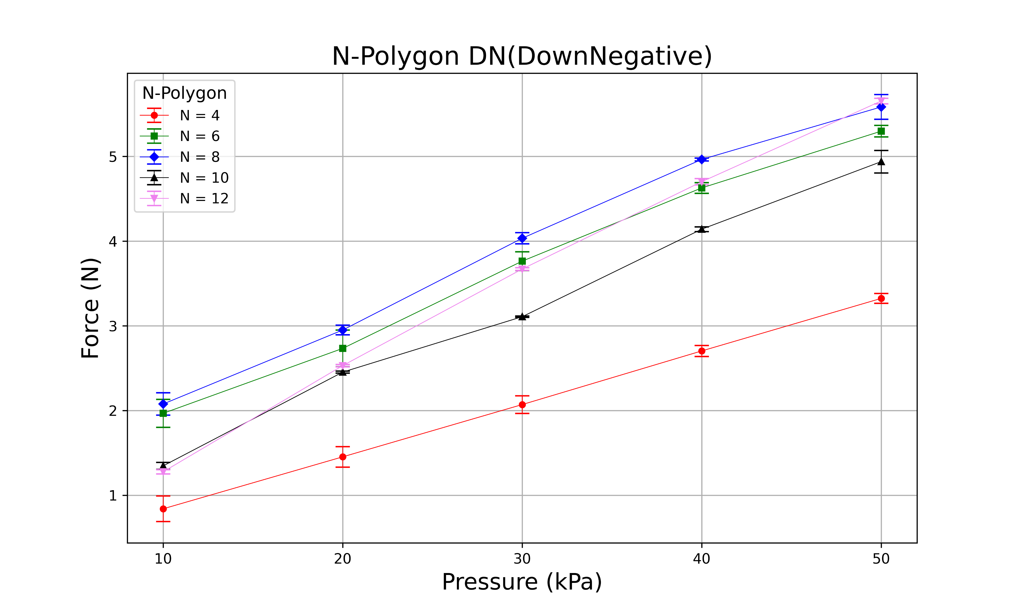
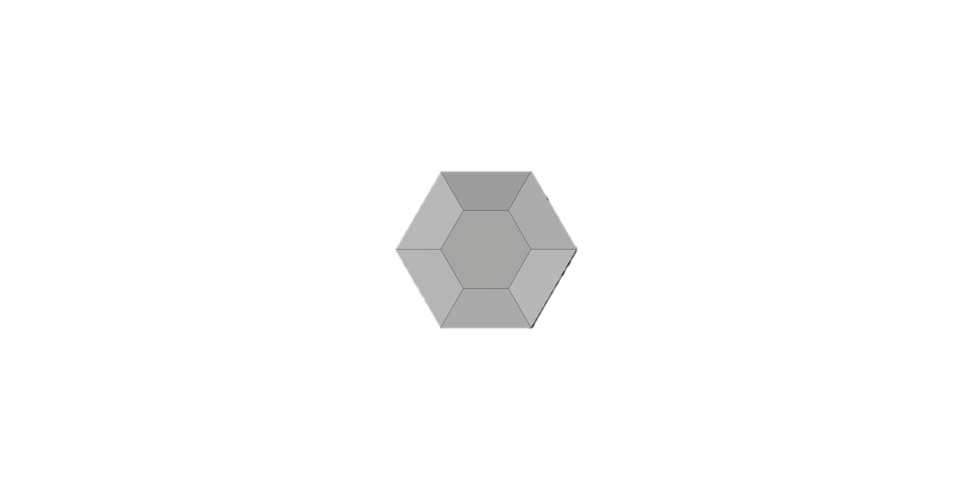
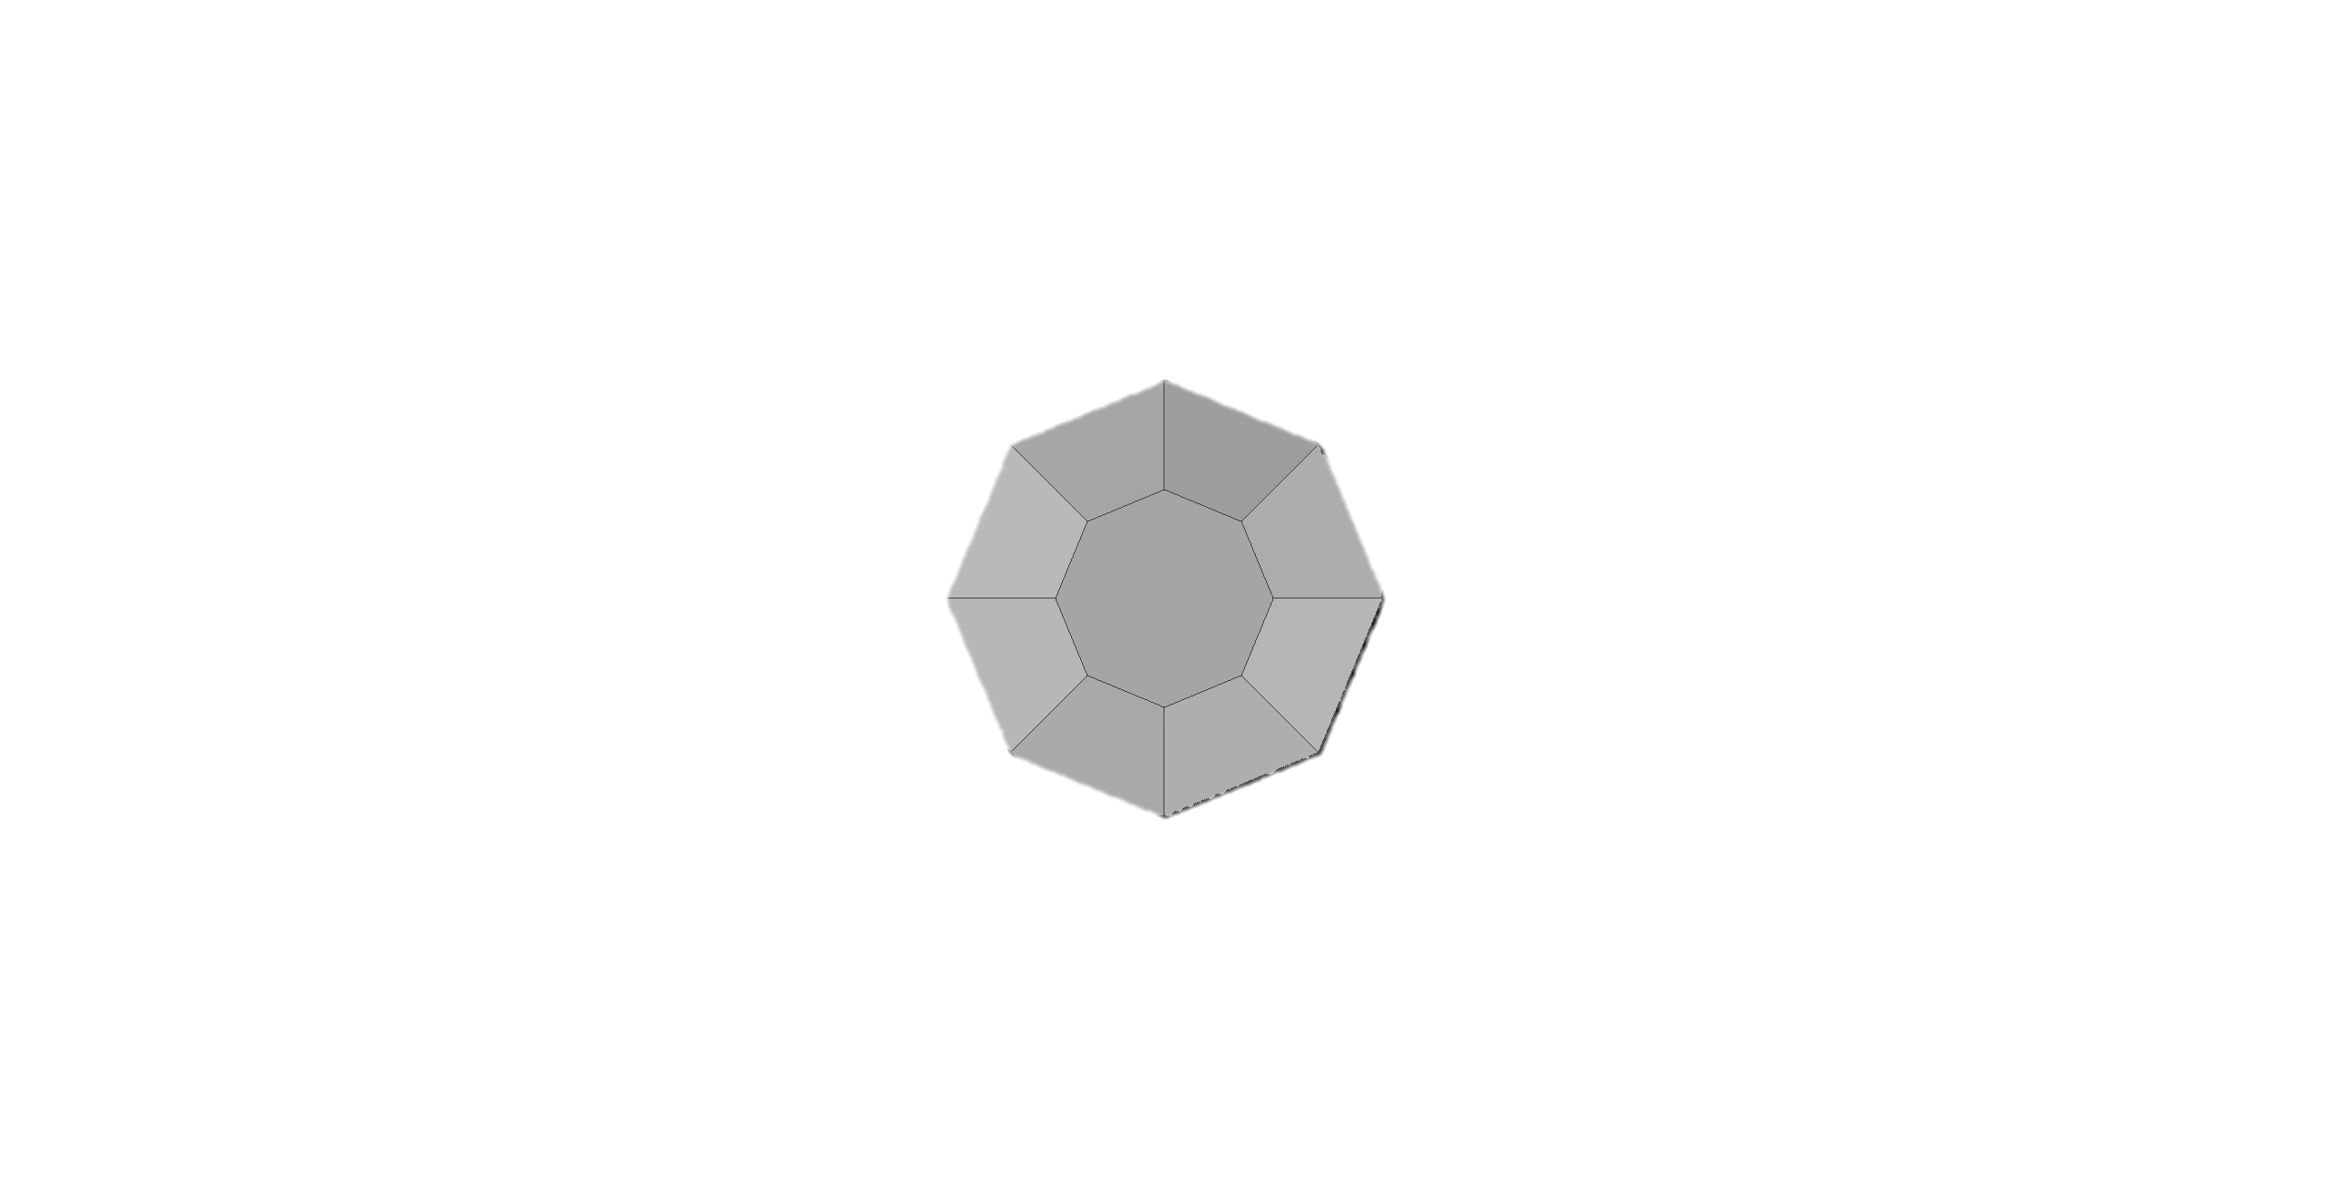
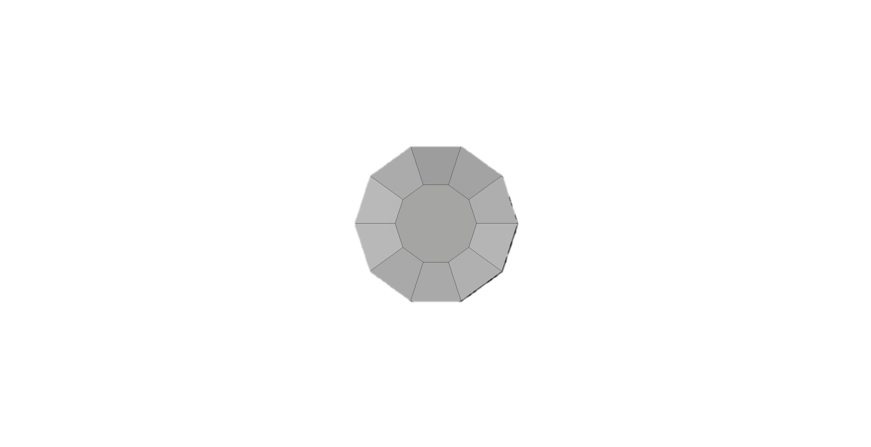
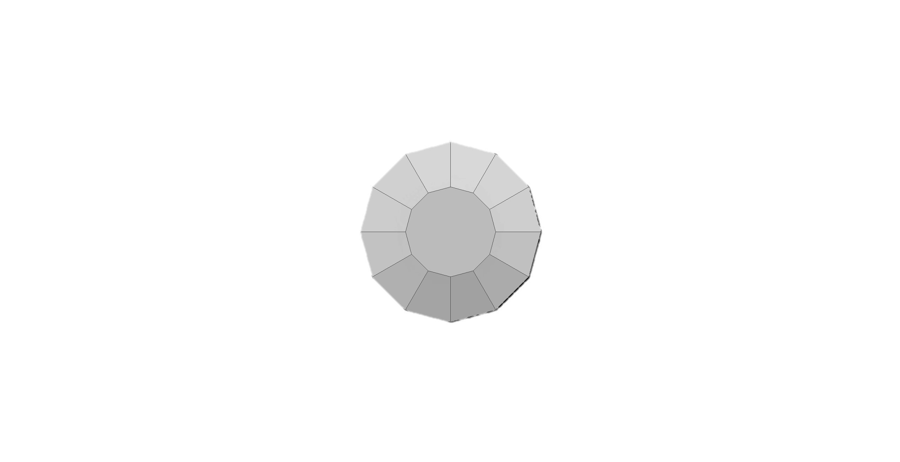
N = 4
N = 6
N = 8
N = 10
N = 12

Slide 30
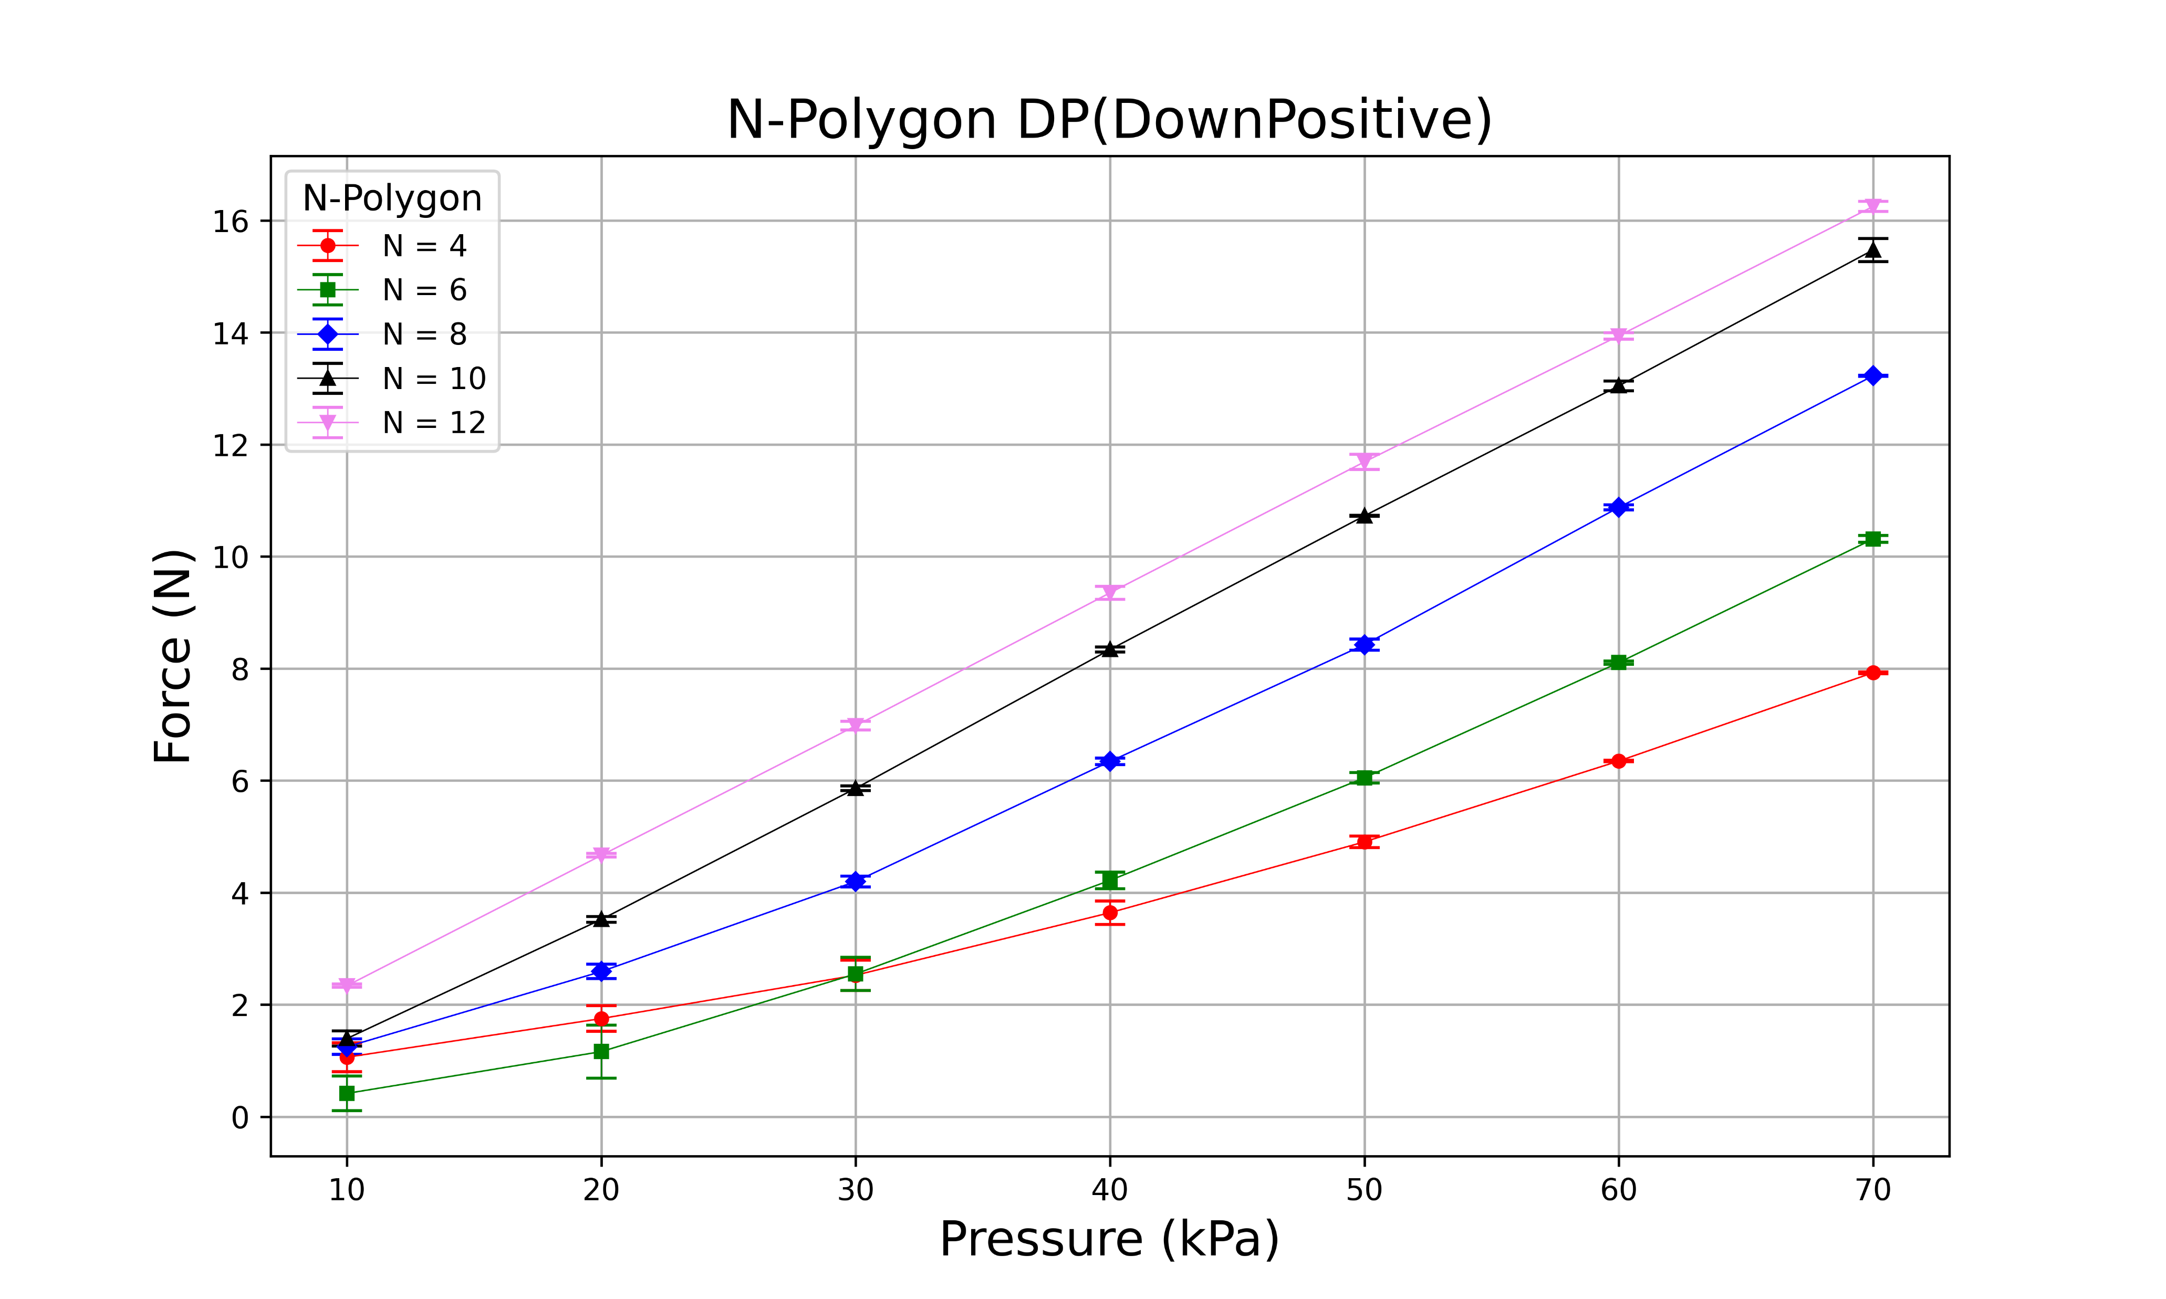
N = 4
N = 6
N = 8
N = 10
N = 12

Slide 31
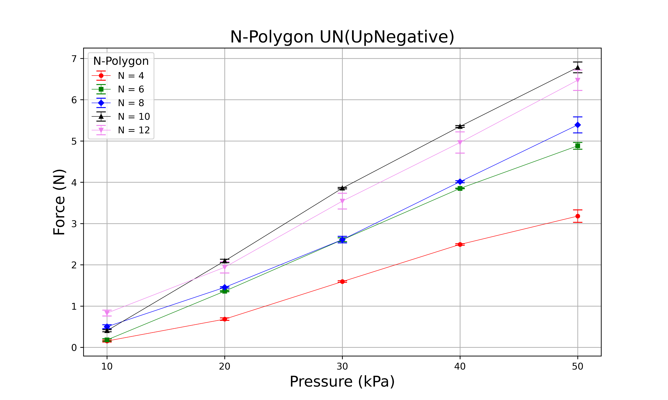
N = 4
N = 6
N = 8
N = 10
N = 12

Slide 32
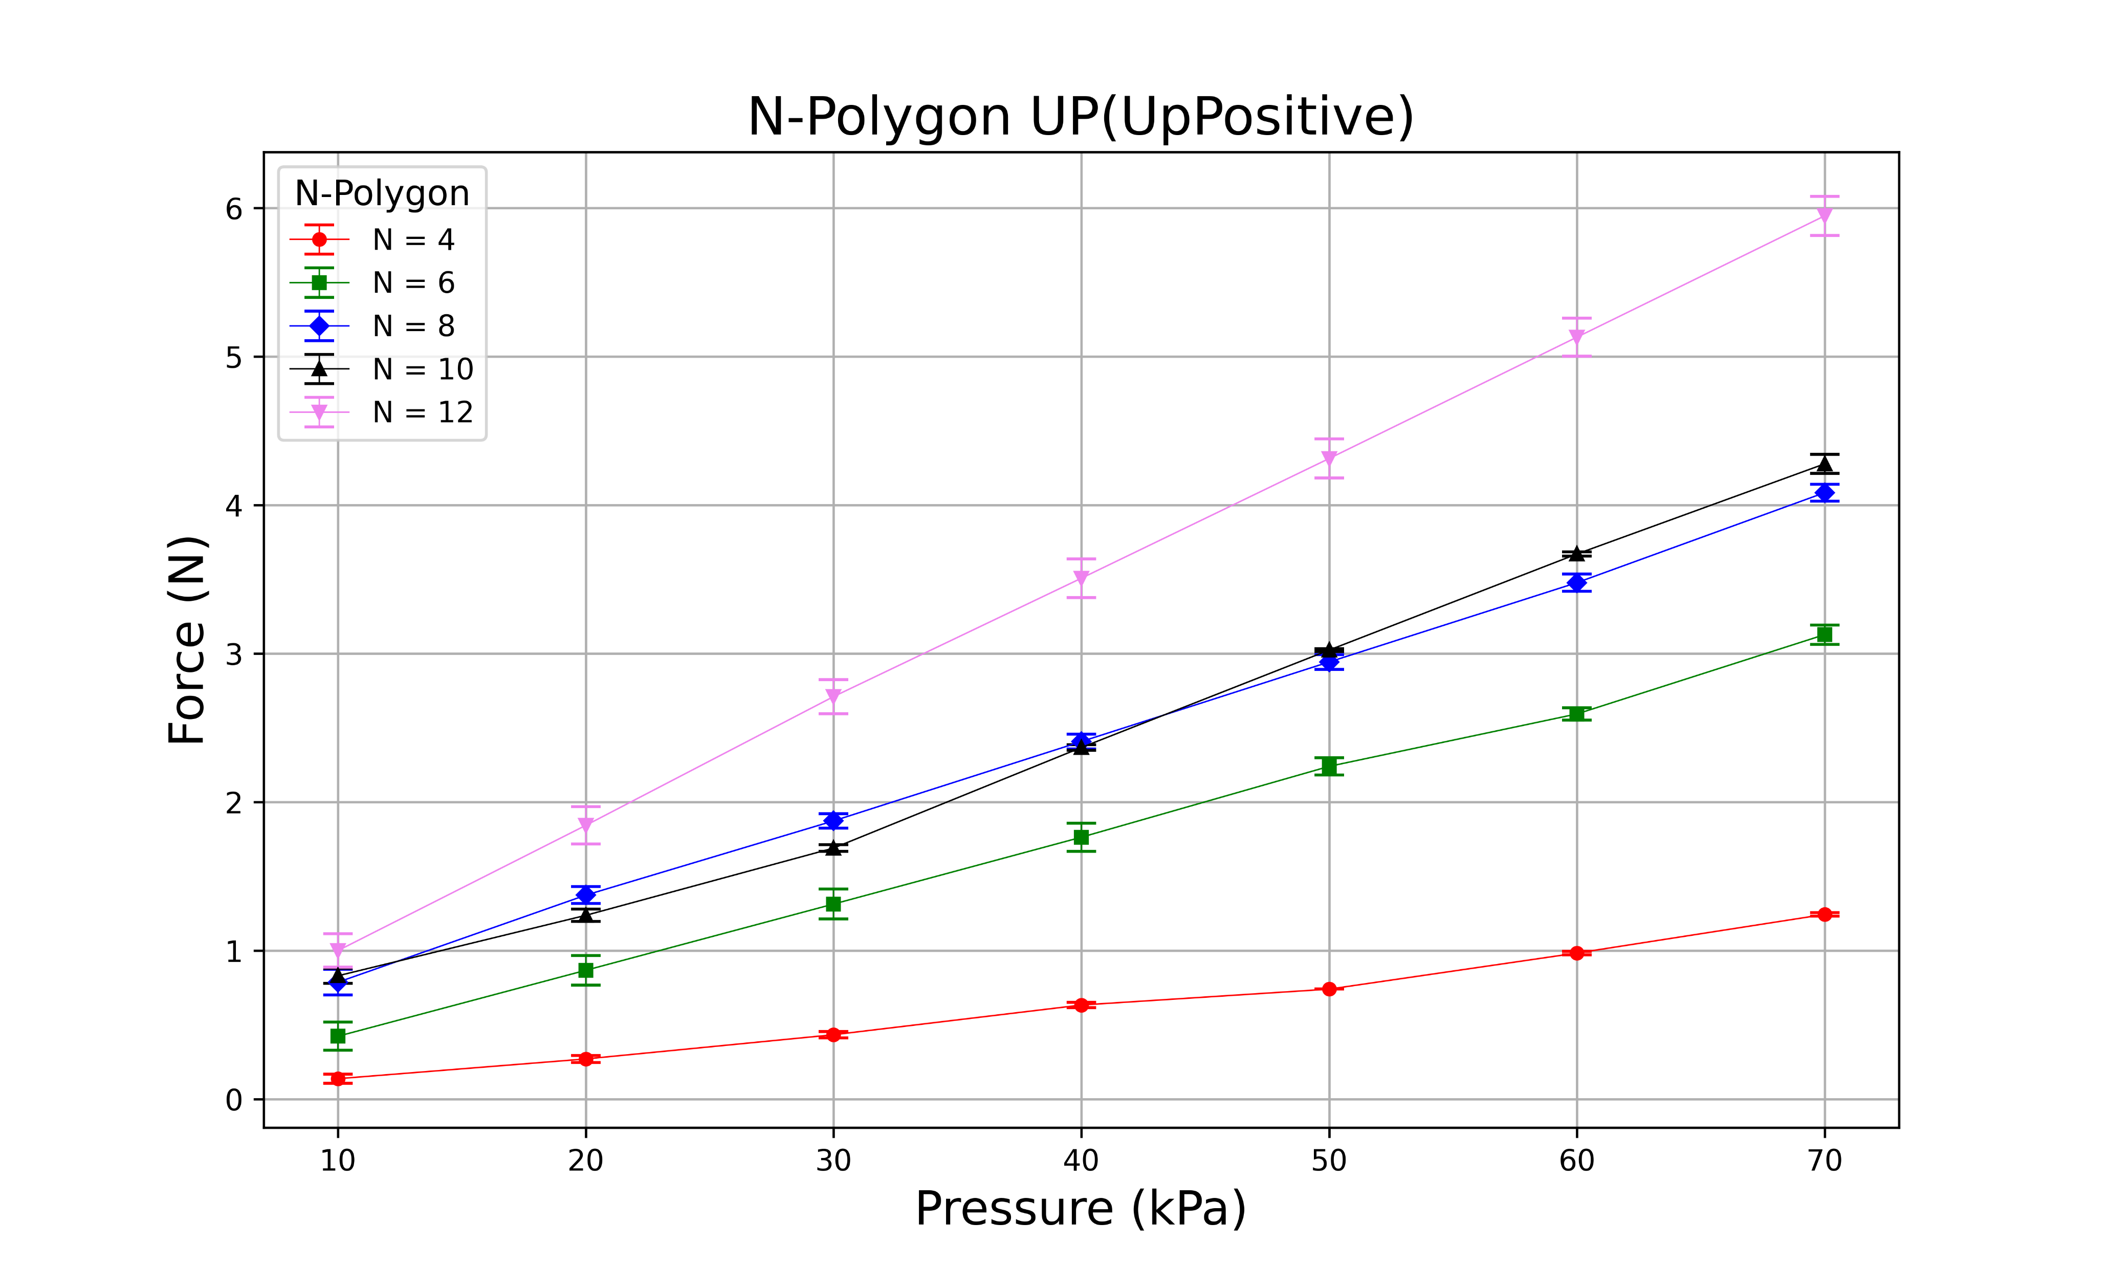
N = 4
N = 6
N = 8
N = 10
N = 12

Slide 33

N = 4
N = 6
N = 8
N = 10
N = 12

Slide 34

N = 4
N = 6
N = 8
N = 10
N = 12

Slide 35

N = 4
N = 6
N = 8
N = 10
N = 12

Slide 36

N = 4
N = 6
N = 8
N = 10
N = 12

